Slide 1
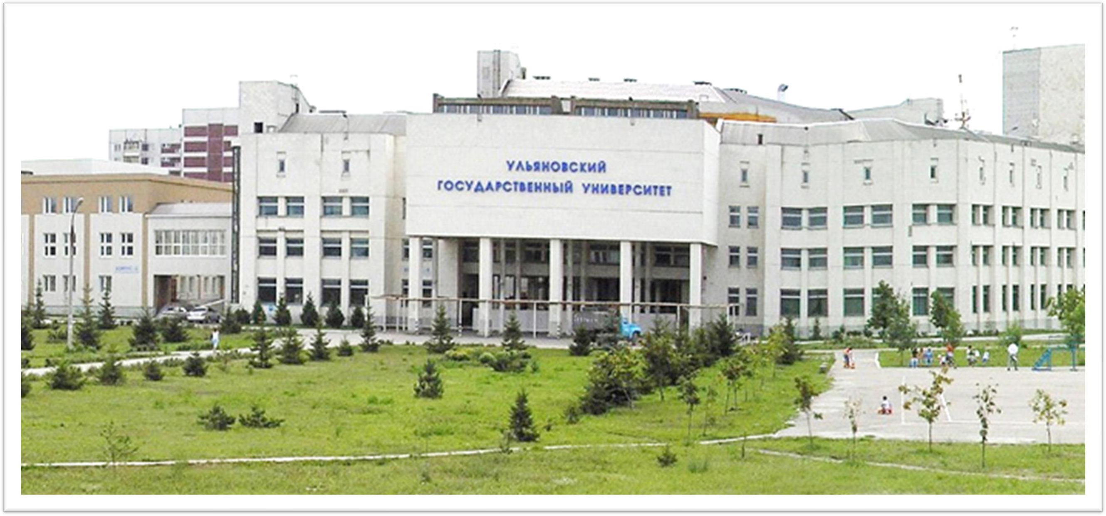
LOCATION: ULYANOVSK, RUSSIA
August 1988
University Type: Government
ULYANOVSK STATE UNIVERSITY

Slide 2
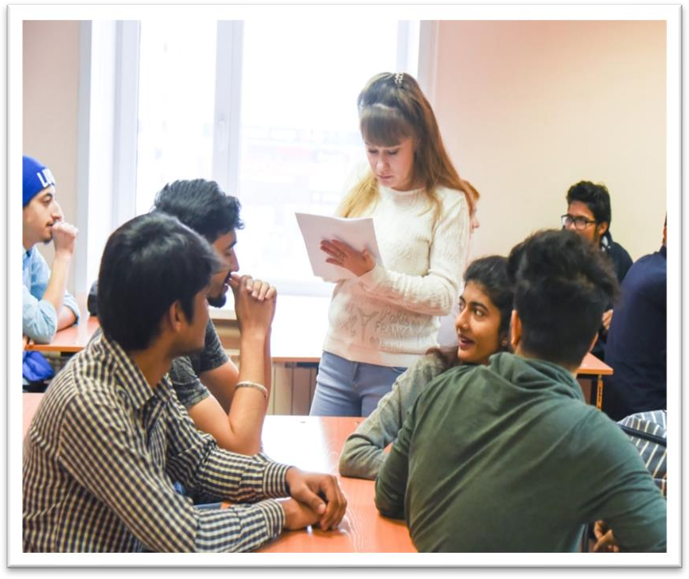
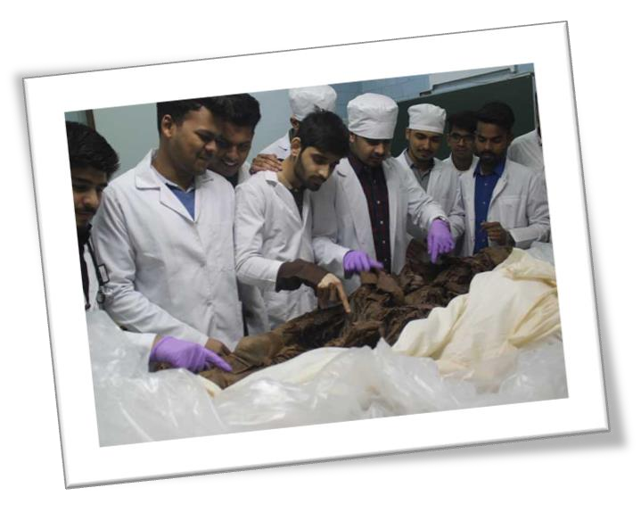
ELIGIBILITY CRITERIA
You are at least 17 years old.
You have passed Class 12th with PCB and English subjects from a board recognized by the Authorities in India.
You have secured a minimum of 50%(GEN) / 40%(OTHER) in PCB in 10+2.
You have qualified NEET Exam.
AT ULYANOVSK STATE UNIVERSITY
The total duration of MBBS Course at Ulyanovsk State University is 6years including internship.
The practical / Internship for 1 year must be completed in India post course completion in abroad and after clearing FMGE / NEXT exam in India.
The Tuition fee is low and affordable with a great value.
Easy admission process, and the best selection process in university.
Medical degrees from Ulyanovsk State University are globally recognized and ranked by WHO.
Indian students who are looking to study MBBS in Ulyanovsk State University have English medium MBBS course, so, no language barrier.
The strength of the batch is limited, every student gets the individual attention of the teachers.
Ulyanovsk State University is much more affordable than that of private colleges in India.
No discrimination based on caste, gender, religion or nationality.

Slide 3
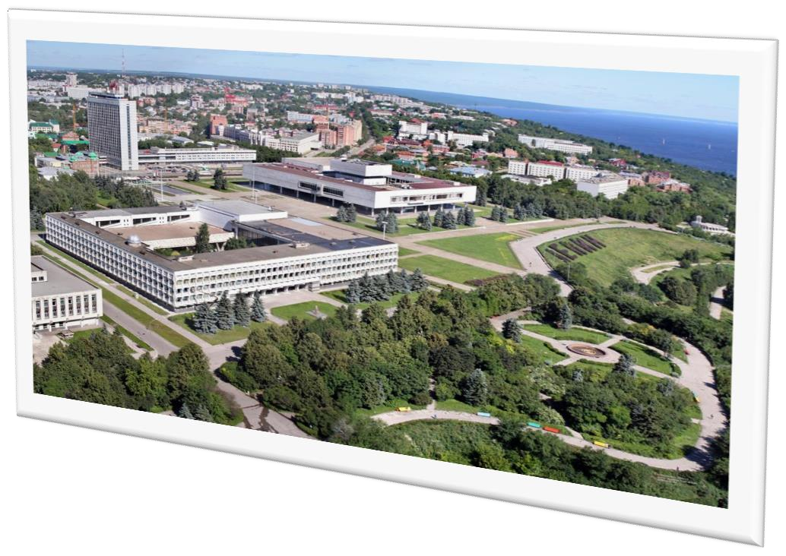
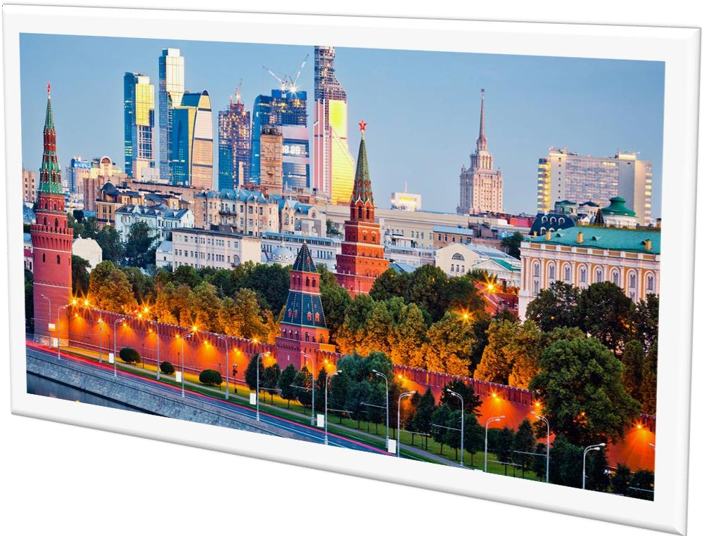
ULYANOVSK CITY
Ulyanovsk is a western Russian city beside the Volga River, known as the birthplace of Soviet leader Vladimir Lenin.
It is also famous for its writers, such as Ivan Goncharov, Nikolay Yazykov and Nikolay Karamzin, and painters such as Arkady Plastov and Nikas Safronov.
It is located in the Volga Federal District. Its administrative center is the city of Ulyanovsk.
The population of Ulyanovsk is 6,15,000 approx.
WHY STUDY IN RUSSIA
Ulyanovsk State Medical University Russia Has become a famous MBBS study-abroad Location for Indian students. Russia is the Country with the second-highest number of Indian students studying medical.
The tuition Fee is very affordable as compared to Indian Medical Colleges
Russian Universities have the best and Easy Admission Procedure
They are Providing world-class infrastructure with modern facilities in colleges
International Exposure for those who are also from Different country backgrounds

Slide 4
ULYANOVSK STATE UNIVERSITY RUSSIA, ESTABLISHED IN: 1988
PARTICULARS | 1ST YEAR | 2ND YEAR | 3rd YEAR | 4th YEAR | 5th YEAR | 6th YEAR
TUITION FEE | 352000 RUB | 352000 RUB | 352000 RUB | 352000 RUB | 352000 RUB | 352000 RUB
HOSTEL | 80000 RUB | 80000 RUB | 80000 RUB | 80000 RUB | 80000 RUB | 80000 RUB
INSURANCE | 8000 RUB | 8000 RUB | 8000 RUB | 8000 RUB | 8000 RUB | 8000 RUB
MEDICAL | 8000 RUB | NA | NA | NA | NA | NA
REGISTRATION, DOCUMENT TRANSLATION, NOTARIZATION, LEGALIZATION, INVITATION, VISA EXTENSION, STUDENT CARD, LIBRARY CARD, EQUIVALENCE CERTIFICATE, ACCESS TO ENGLISH BOOKS FOR ALL SUBJECTS. | 21000 RUB | VISA EXTENSION ON ACTUALS | VISA EXTENSION ON ACTUALS | VISA EXTENSION ON ACTUALS | VISA EXTENSION ON ACTUALS | VISA EXTENSION ON ACTUALS
ADMINISTRATIVE CHARGE (OTC) | 1300$ | NA | NA | NA | NA | NA
BIOMETRIC, FINGERPRINTING CHARGES WILL BE ON ACTUALS TO BE PAID BY STUDENT SEPERATELY.
MESS MANDATORY FOR 1ST YEAR 1300$

