Slide 1
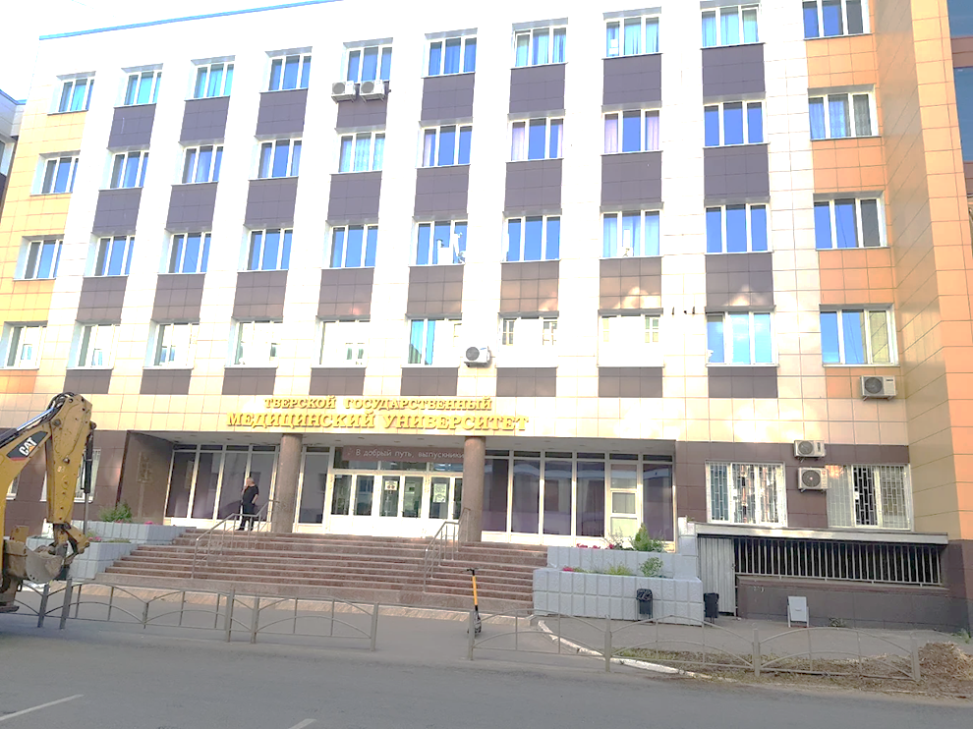
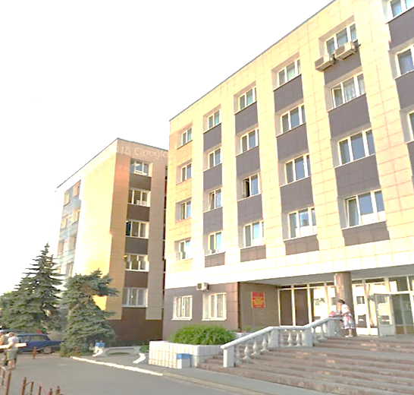

Estb.1902
TVER STATE MEDICAL UNIVERSITY
Tver State Medical University was established in 1902 in Tver, Russia. The Tver State Medical University is one of the oldest universities as well as famous for its medical program The university is governed by the Ministry of Education of the Russian Federation and the Ministry of Health and Social Development. Tver State Medical University is a public university and this university has been serving for more than 80 years of medical programs to students from all over the world. The university holds a good ranking in Russia and the medical program is also very affordable.

Slide 2
Tver State Medical University Quick Highlights
Why Choose Tver State Medical University
University Name | Tver State Medical University
Founded Year | 1902
Location | Tver, Russia
Medium of Education | English
University Validation | Approved by WHO and NMC
Entrance Exam | NEET (Qualifying Marks)
Popular Course | MBBS
Course Duration | 5.8 Year Including Internship
Eligibility Criteria | 50% in 12th Boards with Physics, Chemistry & Biology
IELTS/TOEFL | Not Required
Intake | September
The university has an intake of hundreds of Indian students as well as thousands of overseas students from more than 40 countries.
Provides affordable Tver State Medical University MBBS fees and enables access to quality education for everyone.
Offers excellent medical education suitable for Indian students; the course is taught in English.
A top government medical university in Russia, acknowledged by the WHO and the NMC.
Offers exposure to tertiary hospitals and research institutions for practical bedside training.
Provides modern hostel facilities with standards appropriate for foreign students.
It is one of Russia's oldest and most reputed institutes for MBBS studies.
Collaborates with leading foreign universities to provide more opportunities for students.
Provides a quiet and secure atmosphere for international students.
Reports high success rates for Indian graduates in FMGE, higher than the national average.
The faculty is highly experienced and internationally trained
Duration of MBBS in Tver State Medical University
Total Duration | 6 years (5 years of academic education + 1-year internship).
Internship | Mandatory clinical practice in affiliated hospitals.

Slide 3
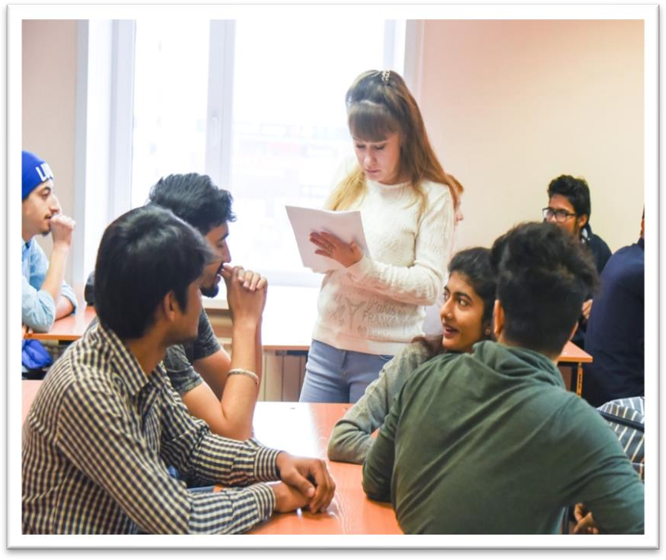
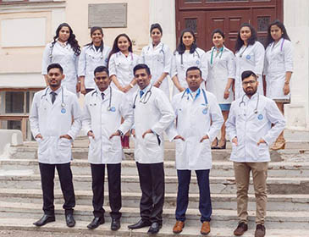
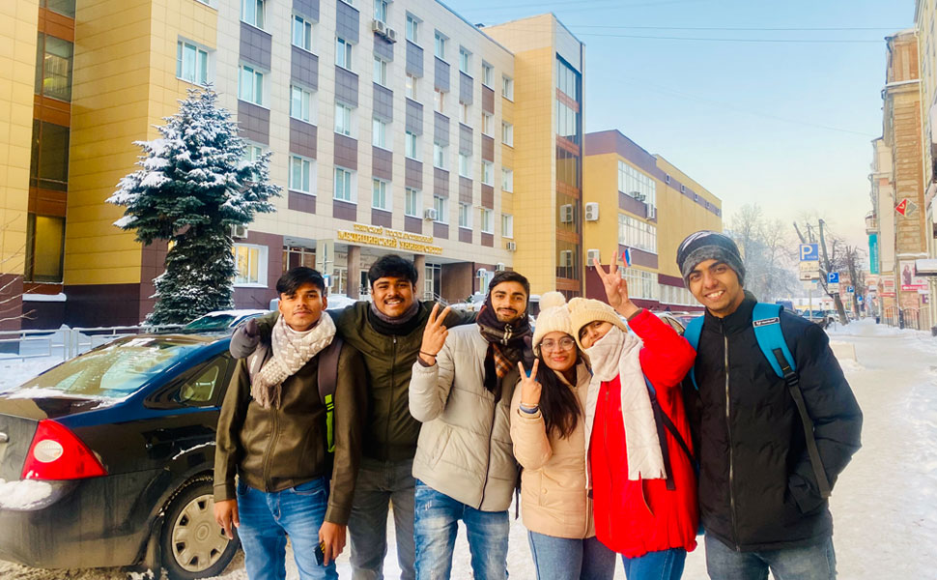
ELIGIBILITY CRITERIA
You are at least 17 years old.
You have passed Class 12th with PCB and English subjects from a board
recognized by the Authorities in India.
You have secured a minimum of 50%(GEN) / 40%(OTHER) in PCB in 10+2.
You have qualified NEET Exam.
FOR STUDENTS
The practical / Internship for 1 year must be completed in India post course
completion in abroad and after clearing FMGE / NEXT exam in India.
The Tuition fee is low and affordable with a great value.
Easy admission process, and the best selection process in university.
Medical degrees from Tver state Medical University are globally recognized and
ranked by WHO.
Indian students who are looking to study MBBS in Tver state Medical University
have English medium MBBS course, so, no language barrier.
The strength of the batch is limited, every student gets the individual attention of
the teachers.
Tver state Medical University is much more affordable than that of private
colleges in India.
No discrimination based on caste, gender, religion or nationality.

Slide 4
TVER STATE MEDICAL UNIVERSITY RUSSIA, ESTABLISHED IN: 1902
PARTICULARS | 1ST YEAR | 2ND YEAR | 3rd YEAR | 4th YEAR | 5th YEAR | 6th YEAR
TUITION FEE | 430000 RUB | 430000 RUB | 430000 RUB | 430000 RUB | 430000 RUB | 430000 RUB
HOSTEL | 100000 RUB | 100000 RUB | 100000 RUB | 100000 RUB | 100000 RUB | 100000 RUB
INSURANCE | 4500 RUB | 7500 RUB | 7500 RUB | 7500 RUB | 7500 RUB | 7500 RUB
MEDICAL | 8000 RUB | NA | NA | NA | NA | NA
REGISTRATION, DOCUMENT TRANSLATION, NOTARIZATION, LEGALIZATION, INVITATION, VISA EXTENSION, STUDENT CARD, LIBRARY CARD, EQUIVALENCE CERTIFICATE, ACCESS TO ENGLISH BOOKS FOR ALL SUBJECTS. | 21000 RUB | VISA EXTENSION ON ACTUALS | VISA EXTENSION ON ACTUALS | VISA EXTENSION ON ACTUALS | VISA EXTENSION ON ACTUALS | VISA EXTENSION ON ACTUALS
ADMINISTRATIVE CHARGE (OTC) | 1300$ | NA | NA | NA | NA | NA
BIOMETRIC, FINGERPRINTING CHARGES WILL BE ON ACTUALS TO BE PAID BY STUDENT SEPERATELY.
MESS MANDATORY FOR 1ST YEAR 1300$

