Slide 1
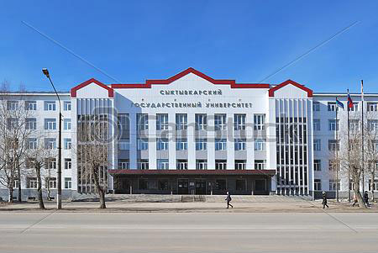

SYKTYVKAR STATE UNIVERSITY
Location: NORTH- WEST, Russia Established in 1972
Syktyvkar State University, which is named after Pitirim Sorokin, a Russian American sociologist, is the Principal University in Syktyvkar,It is the capital of the Komi Republic in Russia. It is also considered as one of the largest Institution for pursuing higher education in North-West Russia. It started its journey in the year 1972. Presently it holds more than 9000 students and more than 600 academic staff.

Slide 2
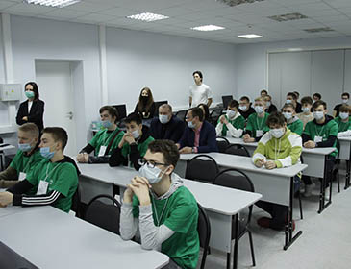
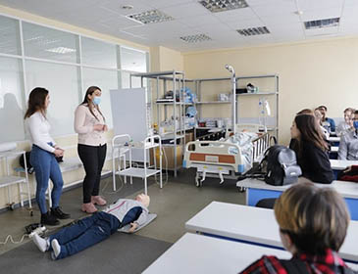

MBBS at SYKTYVKAR STATE UNIVERSITY
The university has 12 institutes with 154 educational programs in all levels of education. It offers about 30 bachelor’s degree programs and 26 master’s degree programs in the fields of natural sciences, technology, jurisprudence, humanities, art, pedagogy, medicine, and economics and management. Fields of international scientific cooperation include ecology, biology, chemistry, medicine, economics, philology, and art and design.
Along with the above specializations, nearly 40 international scientific educational projects are being conducted at the university, in addition to which international and all-Russian scientific conferences are being regularly held.
Students from India and other foreign countries are choosing Russia in present days as their favorite destination for higher study. Syktyvkar State University is one of them.

Slide 3
SYKTYVKAR STATE UNIVERSITY RUSSIA, ESTABLISHED IN: 1972
PARTICULARS | 1ST YEAR | 2ND YEAR | 3rd YEAR | 4th YEAR | 5th YEAR | 6th YEAR
TUITION FEE | 300350 RUB | 300350 RUB | 300350 RUB | 300350 RUB | 300350 RUB | 300350 RUB
HOSTEL | 25000 RUB | 25000 RUB | 25000 RUB | 25000 RUB | 25000 RUB | 25000 RUB
INSURANCE | 7500 RUB | 7500 RUB | 7500 RUB | 7500 RUB | 7500 RUB | 7500 RUB
MEDICAL | 8000 RUB | NA | NA | NA | NA | NA
REGISTRATION, DOCUMENT TRANSLATION, NOTARIZATION, LEGALIZATION, INVITATION, VISA EXTENSION, STUDENT CARD, LIBRARY CARD, EQUIVALENCE CERTIFICATE, ACCESS TO ENGLISH BOOKS FOR ALL SUBJECTS. | 21000 RUB | VISA EXTENSION ON ACTUALS | VISA EXTENSION ON ACTUALS | VISA EXTENSION ON ACTUALS | VISA EXTENSION ON ACTUALS | VISA EXTENSION ON ACTUALS
ADMINISTRATIVE CHARGE (OTC) | 1300$ | NA | NA | NA | NA | NA
BIOMETRIC, FINGERPRINTING CHARGES WILL BE ON ACTUALS TO BE PAID BY STUDENT SEPERATELY.
MESS MANDATORY FOR 1ST YEAR 1300$

