Slide 1
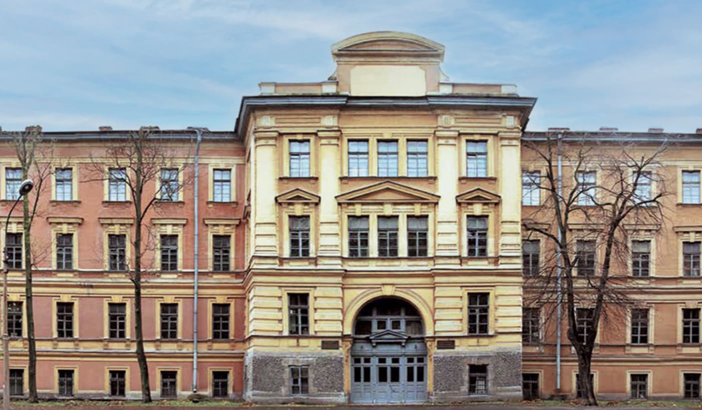
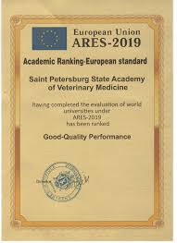
SAINT PETERSBURG STATE UNIVERSITY OF VETERINARY MEDICINE
Saint Petersburg State University of Veterinary Medicine is the oldest education institution and the birthplace of higher veterinary education in Russia, with more than 200 years of history.
Today Saint Petersburg State University of Veterinary Medicine is in Top 3 among the specialized Russian universities for veterinary medicine.

Slide 2
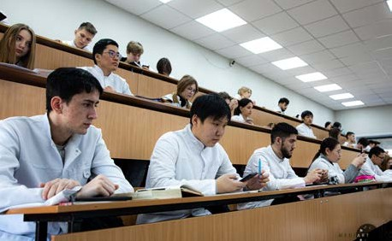
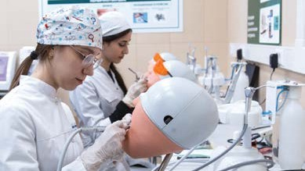
ABOUT UNIVERSTY
In 1994 Leningrad Veterinary Institute was renamed into St. Petersburg State Academy of Veterinary Medicine. In March 2020 St. Petersburg State Academy of Veterinary Medicine was renamed into Saint Petersburg State University of Veterinary Medicine. Today it holds its well-deserved position among the leading educational establishment of the kind. Academy comprises 21 departments, where numerous courses are taught, laboratory and practical classes are being held and research work is being continuously conducted. 14 leading professors of the Academy are associate and corresponding members of the branch academies (International Academy of Agricultural Education, Peter’s Academy of Arts and Sciences, Ecological Academy, Academy of Natural Sciences, etc.). By presidential decrees 8 professors of the Academy were granted the title of Honored Scientist.
ELIGIBILITY CRITERIA
You are at least 17 years old.
You have passed Class 12th with PCB and English subjects from a board recognized by the Authorities in India.
You have secured a minimum of 50%(GEN) / 40%(OTHER) in PCB in 10+2.
You have qualified NEET Exam.

Slide 3
FEE NOT UPDATED FOR SESSION 2026
ST. PETERSBURG STATE OF VETERINARY MEDICINE
PARTICULARS | 1ST YEAR | 2ND YEAR | 3rd YEAR | 4th YEAR | 5th YEAR | 6th YEAR
TUITION FEE | 390000 RUB | 390000 RUB | 390000 RUB | 390000 RUB | 390000 RUB | 390000 RUB
HOSTEL | 20000 RUB | 20000 RUB | 20000 RUB | 20000 RUB | 20000 RUB | 20000 RUB
INSURANCE | 7500 RUB | 8000 RUB | 8000 RUB | 8000 RUB | 8000 RUB | 8000 RUB
MEDICAL | 8000 RUB | NA | NA | NA | NA | NA
REGISTRATION, DOCUMENT TRANSLATION, NOTARIZATION, LEGALIZATION, INVITATION, VISA EXTENSION, STUDENT CARD, LIBRARY CARD, EQUIVALENCE CERTIFICATE, ACCESS TO ENGLISH BOOKS FOR ALL SUBJECTS. | 21000 RUB | VISA EXTENSION ON ACTUALS | VISA EXTENSION ON ACTUALS | VISA EXTENSION ON ACTUALS | VISA EXTENSION ON ACTUALS | VISA EXTENSION ON ACTUALS
ADMINISTRATIVE CHARGE (OTC) | 1300$ | NA | NA | NA | NA | NA
BIOMETRIC, FINGERPRINTING CHARGES WILL BE ON ACTUALS TO BE PAID BY STUDENT SEPERATELY.

