Slide 1
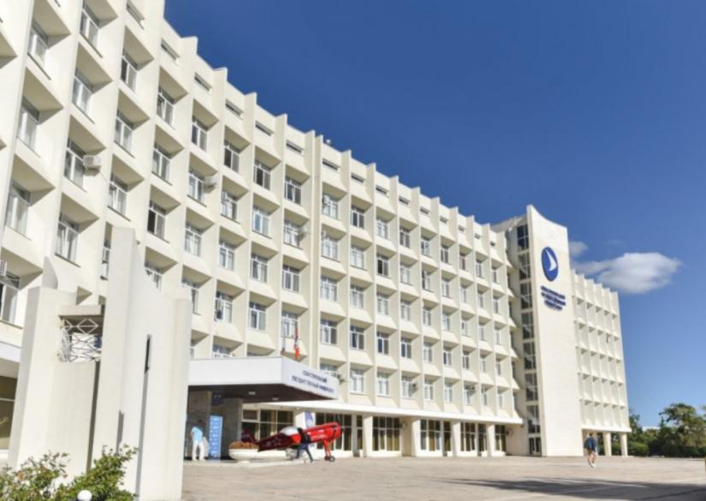

SEVASTOPOL STATE
UNIVERSITY
Location: SEVASTOPOL, Russia
Established: August 2014

Slide 2

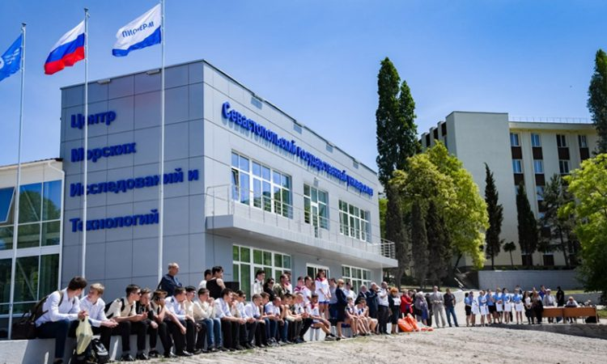
About Sevastopol State University
The Federal State Autonomous Educational Institution of Higher Education "Sevastopol State University", SevGU is the largest higher educational institution of Sevastopol and Crimea. Founded on October 8, 2014 on the basis of a decision of the Government of the Russian Federation. The corresponding decree on the establishment of the university was signed by the Prime Minister of the Russian Federation Dmitry Anatolyevich Medvedev. Since then, on this day, the university is celebrating the day of its birth. April 16, 2015, Sevastopol State University received state accreditation, the corresponding order was signed in the Federal Service for Supervision in Education and Science.

Slide 3

ELIGIBILITY CRITERIA
You are at least 17 years old.
You have passed Class 12th with PCB and English subjects
from a board recognized by the Authorities in India.
You have secured a minimum of 50% in PCB in 10+2.
You have qualified NEET Exam.
CAREER OPPURTUNITIES
Distance Learning Courses for Foreign Citizens
Bachelor's Degree Programs
Specialist's Degree Programs
Master's Degree Programs
Doctorate Programs
Professional training programs
Lifelong learning opportunities
Educational projects
Access to educational activities
Environmental education
Academic Freedom
Process for getting admission in MBBS in Russia is very simple. Russian Medical Universities do not require Indian students to pass any entrance exams for admission in MBBS Course. Admissions are based on a first come first served, subject to the candidate satisfying the eligibility criteria set by the Russian medical University and NMC for Indian students.

Slide 4
FEE NOT UPDATED FOR SESSION 2026
SEVASTOPOL STATE UNIVERSITY RUSSIA, ESTABLISHED IN: 2014
PARTICULARS | 1ST YEAR | 2ND YEAR | 3rd YEAR | 4th YEAR | 5th YEAR | 6th YEAR
TUITION FEE | 287500 RUB | 287500 RUB | 287500 RUB | 287500 RUB | 287500 RUB | 287500 RUB
HOSTEL | 70000 RUB | 70000 RUB | 70000 RUB | 70000 RUB | 70000 RUB | 70000 RUB
INSURANCE | 8000 RUB | 8000 RUB | 8000 RUB | 8000 RUB | 8000 RUB | 8000 RUB
MEDICAL | 8000 RUB | NA | NA | NA | NA | NA
REGISTRATION, DOCUMENT TRANSLATION, NOTARIZATION, LEGALIZATION, INVITATION, VISA EXTENSION, STUDENT CARD, LIBRARY CARD, EQUIVALENCE CERTIFICATE, ACCESS TO ENGLISH BOOKS FOR ALL SUBJECTS. | 21000 RUB | VISA EXTENSION ON ACTUALS | VISA EXTENSION ON ACTUALS | VISA EXTENSION ON ACTUALS | VISA EXTENSION ON ACTUALS | VISA EXTENSION ON ACTUALS
ADMINISTRATIVE CHARGE (OTC) | 1500$ | NA | NA | NA | NA | NA
BIOMETRIC, FINGERPRINTING CHARGES WILL BE ON ACTUALS TO BE PAID BY STUDENT SEPERATELY.

