Slide 1
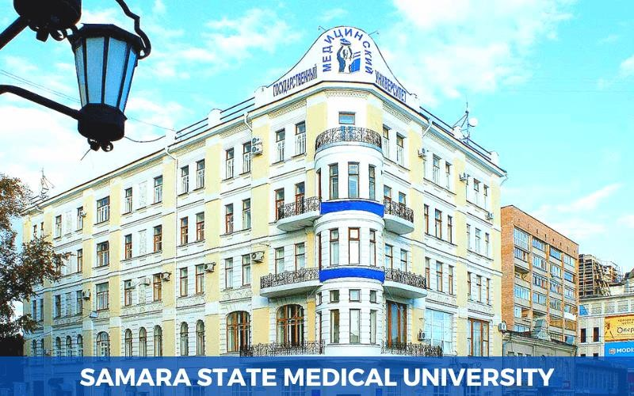


Slide 2
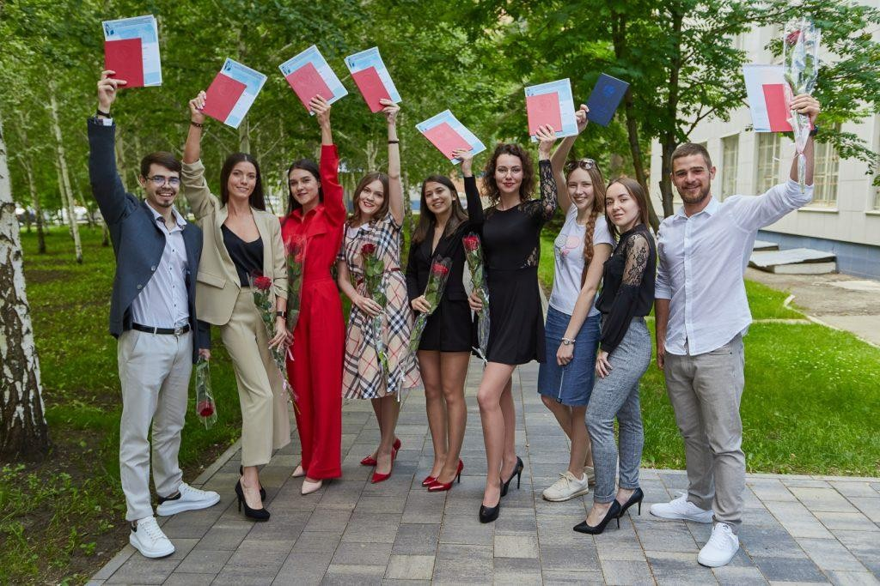
ELIGIBILITY CRITERIA
You are at least 17 and maximum 25 years old on or before 31st December of the admission year.
You have passed Class 12th with PCB and English subjects from a board recognized by the Authorities in India.
You have secured a minimum of 50% in PCB in 10+2.
You have qualified NEET Exam.
CAREER OPPURTUNITIES
Distance Learning Courses for Foreign Citizens
Bachelor's Degree Programs
Specialist's Degree Programs
Master's Degree Programs
Doctorate Programs
Professional training programs
Lifelong learning opportunities
Educational projects
Access to educational activities
Environmental education
Academic Freedom
Process for getting admission in MBBS in Russia is very simple. Russian Medical Universities do not require Indian students to pass any entrance exams for admission in MBBS Course. Admissions are based on a first come first served, subject to the candidate satisfying the eligibility criteria set by the Russian medical University and NMC (*for Indian students).

Slide 3

SAMARA STATE MEDICAL UNIVERSITY, ESTB. 1919
PARTICULARS | 1ST YEAR | 2ND YEAR | 3rd YEAR | 4th YEAR | 5th YEAR | 6th YEAR
TUITION FEE | 450000 RUB | 450000 RUB | 450000 RUB | 450000 RUB | 450000 RUB | 450000 RUB
HOSTEL | 32000 RUB | 32000 RUB | 32000 RUB | 32000 RUB | 32000 RUB | 32000 RUB
MEDICAL | 8000 RUB | NA | NA | NA | NA | NA
INSURANCE | 7500 RUB | 7500 RUB | 7500 RUB | 7500 RUB | 7500 RUB | 7500 RUB
REGISTRATION, DOCUMENT TRANSLATION, NOTARIZATION, LEGALIZATION, INVITATION, VISA EXTENSION, STUDENT CARD, LIBRARY CARD, EQUIVALENCE CERTIFICATE, ACCESS TO ENGLISH BOOKS FOR ALL SUBJECTS. | 21000 RUB | 2000 RUB (VISA EXTENSION) | 2000 RUB (VISA EXTENSION) | 2000 RUB (VISA EXTENSION) | 2000 RUB (VISA EXTENSION) | 2000 RUB (VISA EXTENSION)
ADMINISTRATIVE CHARGE (OTC) | 1300$ | NA | NA | NA | NA | NA
MESS IS MANDATORY 1200$ IN FIRST YEAR. (BIOMETRIC, FINGERPRINTING CHARGES WILL BE ON ACTUALS TO BE PAID BY STUDENT ON ARRIVAL)

