Slide 1
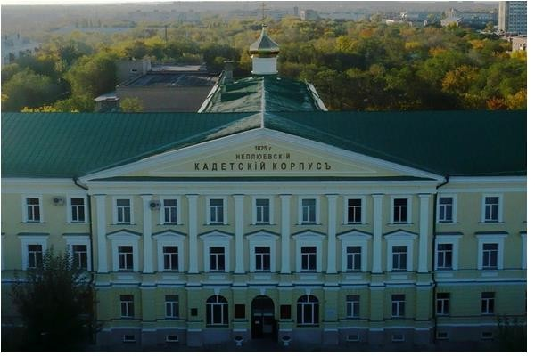



Established, 1944
Orenburg State Medical University offers courses and programs leading to officially recognized higher education degrees such as bachelor’s degrees, master’s degrees, doctorate degrees in several areas of study. Currently, there are eight faculties: Medicine, Pediatric, Stomatology (Dentistry), Pharmacy, Clinical Psychology, Nursing, Public Health.
ORENBURG STATE MEDICAL UNIVERSITY, RUSSIA
2025 | 1ST YEAR | 2ND YEAR | 3RD YEAR | 4TH YEAR | 5TH YEAR | 6TH YEAR
COLLEGE FEE | Included | Included | Included | Included | Included | Included
HOSTEL | Included | Included | Included | Included | Included | Included
HEALTH INSURANCE | Included | Included | Included | Included | Included | Included
REGISTRATION + DOCUMENT TRANSLATION + NOTARIZATION + VISA EXTENSION + AIRPORT PICKUP + ADMINISTRATIVE CHARGE | Included | Included | Included | Included | Included | Included
TOTAL | 7000 $ | 6000$ | 6000$ | 6000 $ | 6000 $ | 6000 $
ADMINISTRATIVE CHARGE (OTC) : 1300$ SERVICE CHARGES & CONSULTATION CHARGES EXTRA TO BE PAID IN INDIA --- MESS MANDATORY 1500$ FOR 1ST YEAR

