Slide 1
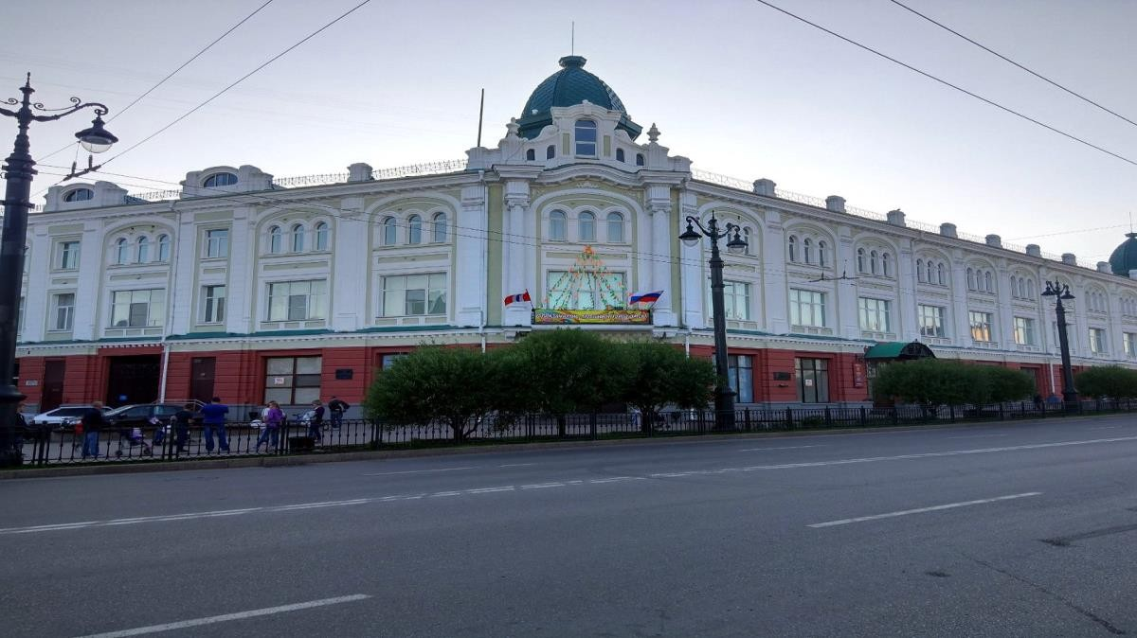
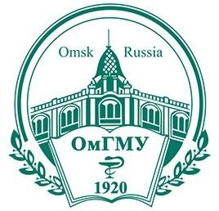
OMSK STATE MEDICAL UNIVERSITY
Established: August 1920
Location: OMSK Oblast, Russia
It was established in 1920 as the medical faculty of the Siberian Institute of Veterinary Medicine and Zoology, and was reorganized in 1921 as the West Siberian State Medical Institute. Omsk State Medical University Russia (OSMU Russia) is the School of Medicine in Omsk, Russia. The university was renamed Omsk State Medical Institute in 1925 and Omsk State Medical Academy in 1994.

Slide 2

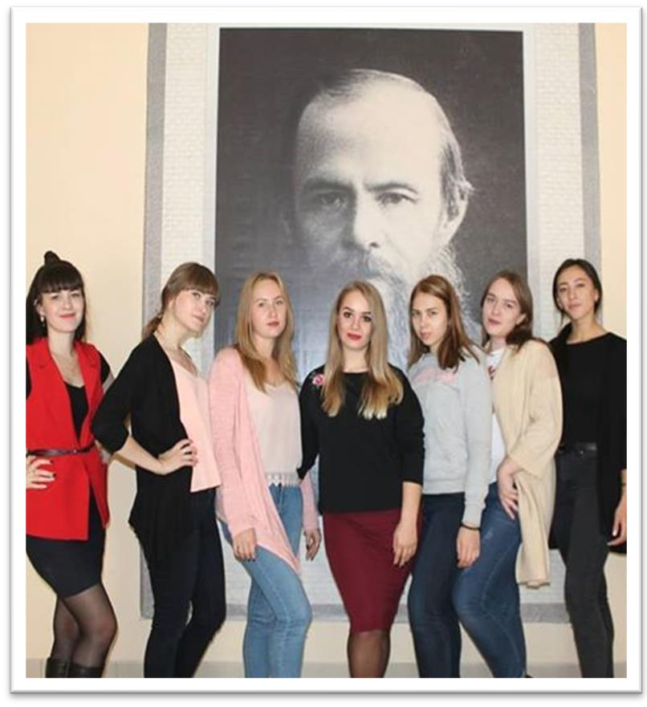
Why study MBBS At Omsk State Medical University.
The Omsk State Medical University hostel provides students with the best living conditions and also ensures that the student should feel as comfortable as possible.
Omsk State Medical University Courses quality medical programs with highly qualified professors
and state-of-the-art infrastructure.
The college is renowned for its undergraduate medical programs (MBBS).
OSMA has 22 specialized sports clubs, including five fitness centers, two large gyms and an Olympic sports complex with pool.
OSMU has creative groups for regional, national and international competitions and thus is a world of opportunities and activities for students.
With over 600,000 printed titles, OSMU has one of the oldest and richest medical libraries in Russia.
Advantages Of Study MBBS In Omsk State Medical University
The medium of instruction for the MBBS course at Omsk State Medical University is English.
The university has a conducive and healthy environment for students.
It is one of the top universities in Russia that provides quality education to students.
There are good dormitory facilities for local as well as international students.
The Omsk State Medical Academy has more than 100 MD-PhD full professors and 300 MD-PhD associate professors.
Students are not required to pay any donation or capitation fee.

Slide 3
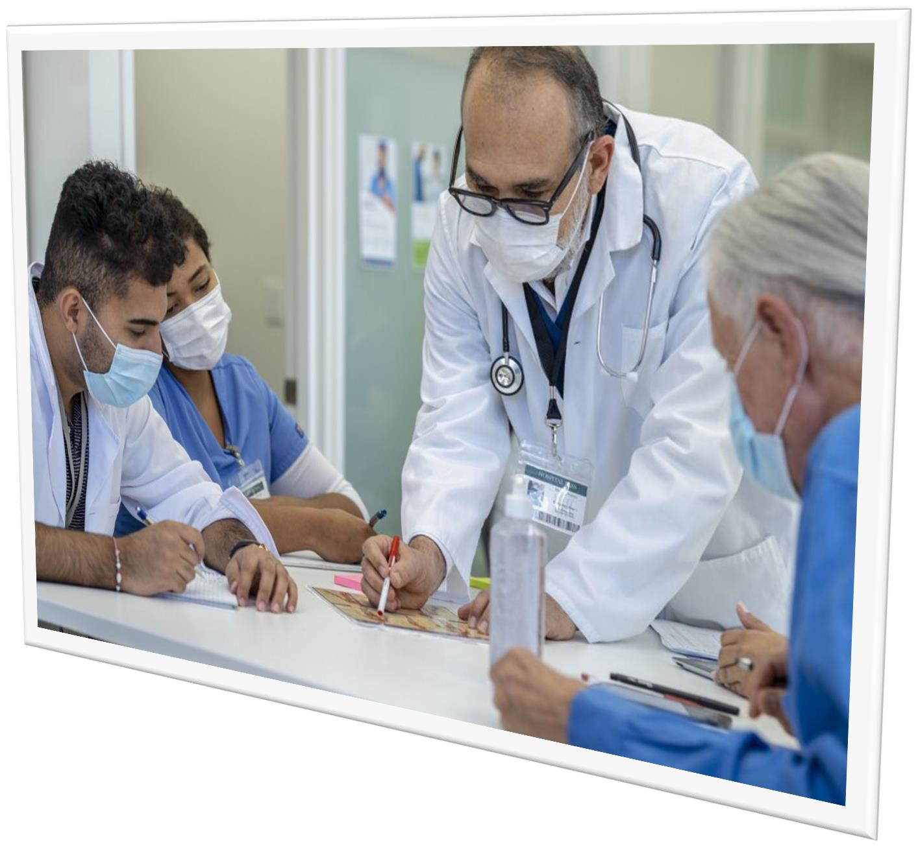
ELIGIBILITY CRITERIA
You are at least 17 years old.
You have passed Class 12th with PCB and English subjects
from a board recognized by the Authorities in India.
You have secured a minimum of 50% in PCB in 10+2.
You have qualified NEET Exam.
CAREER OPPURTUNITIES
Distance Learning Courses for Foreign Citizens
Bachelor's Degree Programs
Specialist's Degree Programs
Master's Degree Programs
Doctorate Programs
Professional training programs
Lifelong learning opportunities
Educational projects
Access to educational activities
Environmental education
Academic Freedom
Process for getting admission in MBBS in Russia is very simple. Russian Medical Universities do not require Indian students to pass any entrance exams for admission in MBBS Course. Admissions are based on a first come first served, subject to the candidate satisfying the eligibility criteria set by the Russian medical University and NMC for Indian students.

Slide 4
OMSK STATE MEDICAL UNIVERSITY RUSSIA, ESTABLISHED IN: 1920
PARTICULARS | 1ST YEAR | 2ND YEAR | 3rd YEAR | 4th YEAR | 5th YEAR | 6th YEAR
TUITION FEE | 370000 RUB | 370000 RUB | 370000 RUB | 370000 RUB | 370000 RUB | 370000 RUB
HOSTEL | 20000 RUB | 20000 RUB | 20000 RUB | 20000 RUB | 20000 RUB | 20000 RUB
INSURANCE | 8000 RUB | 8000 RUB | 8000 RUB | 8000 RUB | 8000 RUB | 8000 RUB
MEDICAL | 8000 RUB | NA | NA | NA | NA | NA
REGISTRATION, DOCUMENT TRANSLATION, NOTARIZATION, LEGALIZATION, INVITATION, VISA EXTENSION, STUDENT CARD, LIBRARY CARD, EQUIVALENCE CERTIFICATE, ACCESS TO ENGLISH BOOKS FOR ALL SUBJECTS. | 21000 RUB | VISA EXTENSION ON ACTUALS | VISA EXTENSION ON ACTUALS | VISA EXTENSION ON ACTUALS | VISA EXTENSION ON ACTUALS | VISA EXTENSION ON ACTUALS
ADMINISTRATIVE CHARGE (OTC) | 1500$ | NA | NA | NA | NA | NA
BIOMETRIC, FINGERPRINTING CHARGES WILL BE ON ACTUALS TO BE PAID BY STUDENT SEPERATELY.

