Slide 1
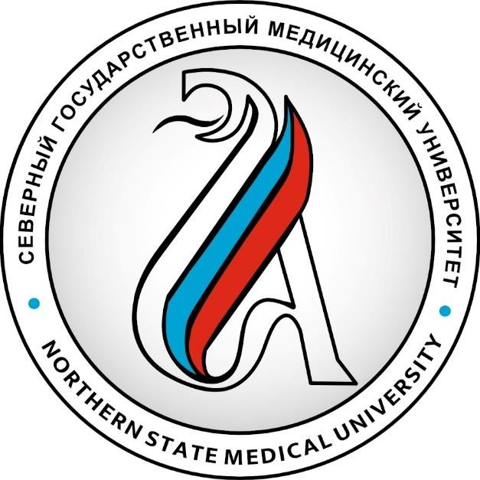
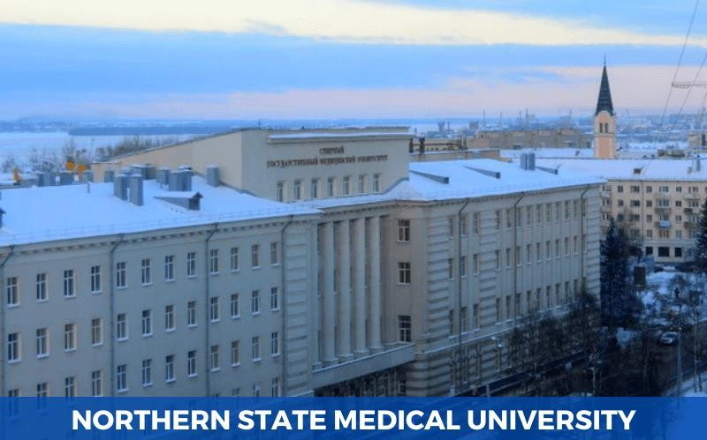
NORTHERN STATE MEDICAL UNIVERSITY
ESTABLISHED IN AUGUST 1936
Northern State Medical University came into existence in the year 1932 and is one of the renowned universities in Russia when it comes to top ranked places when it comes to pursuing MBBS in Northern State Medical University. The fee structure of the University is also reasonable compared to other well-known universities in Russia. NSMU has contact with some of the reputed hospitals in Russia and ties up with few foreign corporations that assures the security of the career.

Slide 2
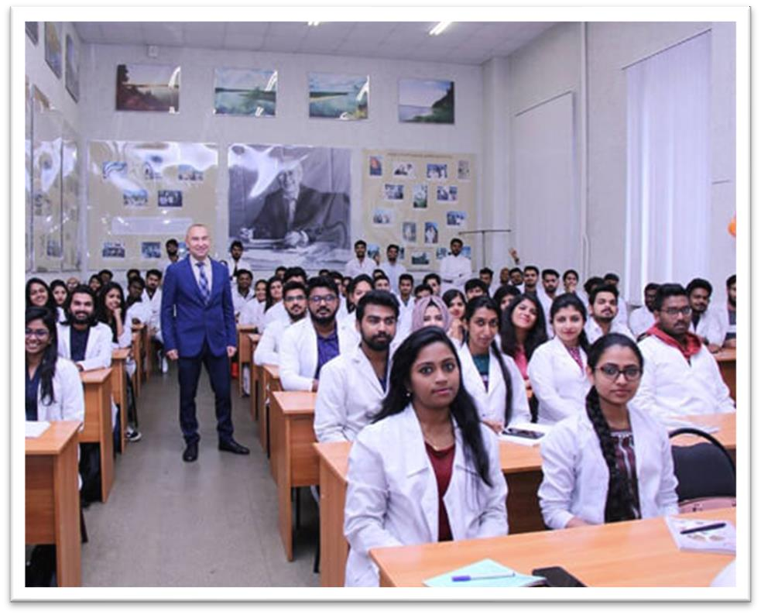
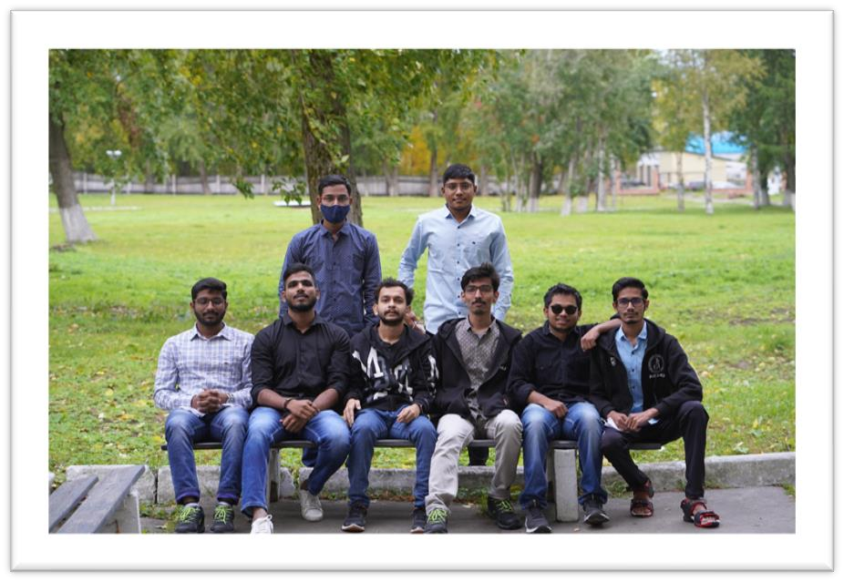
Why Study MBBS at Northern State Medical University?
Northern State Medical University is one of the top-ranked government universities.
It offers a low-cost fee structure which makes it very much affordable for Indian students.
It has a successful history of almost 14 decades.
The teaching medium for the MBBS course is English and Russian as well, so that
the students can attend the batches as per their preference.
Indian food is readily available for Indians near the university.
International Students’ Education:
International students are being trained at Northern State Medical University of Federal Agency for Health and Social Development since 1992. The academy is proud to have trained 216 specialists from 26 near abroad and far abroad countries. After pursuing graduation from the Northern State Medical University of Federal Agency for Health and Social Development, international students can expect opportunities to continue training as interns, or take clinical studies, or pursue the post-graduate course.

Slide 3
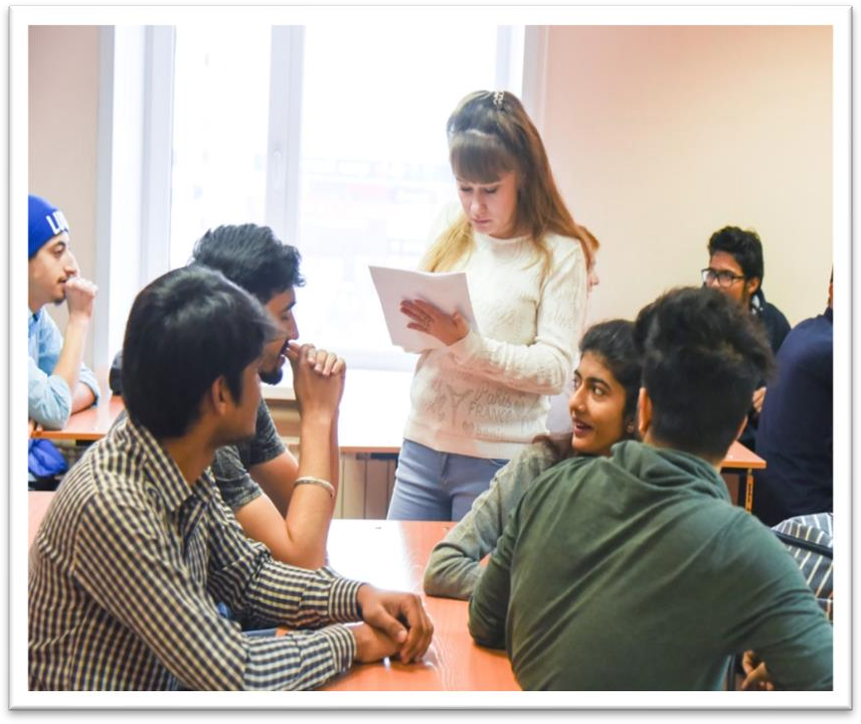
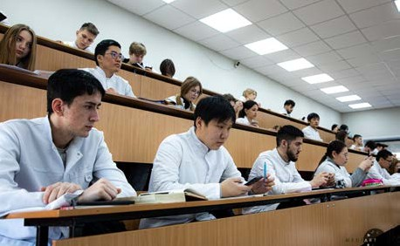
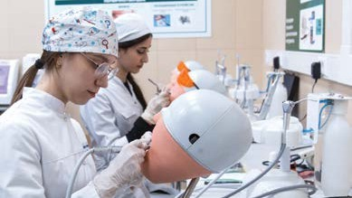
ELIGIBILITY CRITERIA
You are at least 17 years old.
You have passed Class 12th with PCB and English subjects from a board recognized by the Authorities in India.
You have secured a minimum of 50%(GEN) / 40%(OTHER) in PCB in 10+2.
You have qualified NEET Exam.
AT NORTHERN STATE MEDICAL UNIVERSITY
The total duration of MBBS Course at Northern State Medical University is 6years including internship.
The practical / Internship for 1 year must be completed in India post course completion in abroad and after clearing FMGE / NEXT exam in India.
The Tuition fee is affordable with a great value as compared to Indian Medical Colleges.
Easy admission process, and the best selection process in university.
Medical degrees from Northern State Medical University are globally recognized and ranked by WHO.
Indian students who are looking to study MBBS in Northern State Medical University have English medium MBBS course, so, no language barrier.
The strength of the batch is limited, every student gets the individual attention of the teachers.
No discrimination based on caste, gender, religion or nationality.

Slide 4
NORTHERN STATE MEDICAL UNIVERSITYRUSSIA, FOUNDED IN: 1936
PARTICULARS | 1ST YEAR | 2ND YEAR | 3rd YEAR | 4th YEAR | 5th YEAR | 6th YEAR
TUITION FEE | 350000 RUB | 350000 RUB | 350000 RUB | 350000 RUB | 350000 RUB | 350000 RUB
HOSTEL | 30000 RUB | 30000 RUB | 30000 RUB | 30000 RUB | 30000 RUB | 30000 RUB
INSURANCE | 10000 RUB | 10000 RUB | 10000 RUB | 10000 RUB | 10000 RUB | 10000 RUB
MEDICAL | 8000 RUB | NA | NA | NA | NA | NA
REGISTRATION, DOCUMENT TRANSLATION, NOTARIZATION, LEGALIZATION, INVITATION, VISA EXTENSION, STUDENT CARD, LIBRARY CARD, EQUIVALENCE CERTIFICATE, ACCESS TO ENGLISH BOOKS FOR ALL SUBJECTS. | 21000 RUB | VISA EXTENSION ON ACTUALS | VISA EXTENSION ON ACTUALS | VISA EXTENSION ON ACTUALS | VISA EXTENSION ON ACTUALS | VISA EXTENSION ON ACTUALS
ADMINISTRATIVE CHARGE (OTC) | 1300$ | NA | NA | NA | NA | NA
BIOMETRIC, FINGERPRINTING CHARGES WILL BE ON ACTUALS TO BE PAID BY STUDENT SEPERATELY.

