Slide 1
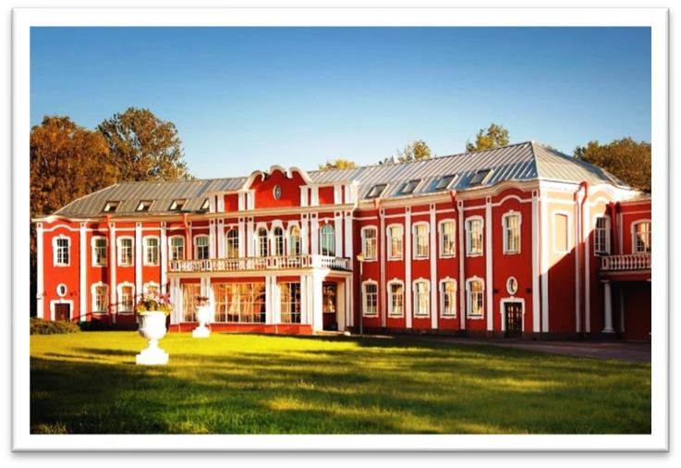
NORTH WESTERN STATE MEDICAL UNIVERSITY
NAMED AFETER I.I. MECHNIKOV
Founded in OCTOBER 12, 2011
This University is a result of a successful merger of two ancient Russian medical academies. The University has become the successor of a long history, rich experience, age-old traditions of two medical institutes of St. Petersburg at once.

Slide 2
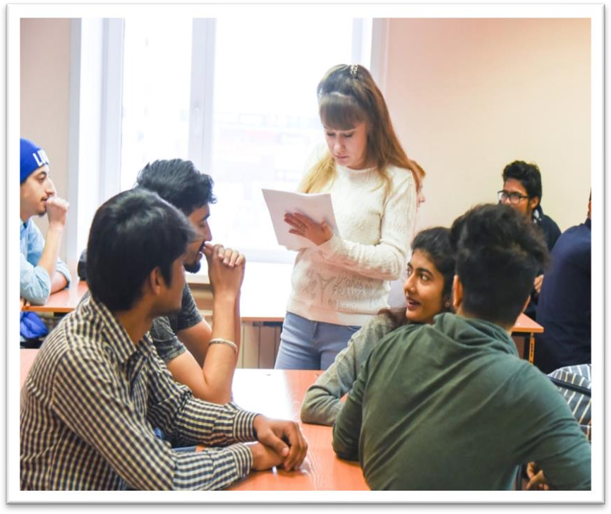
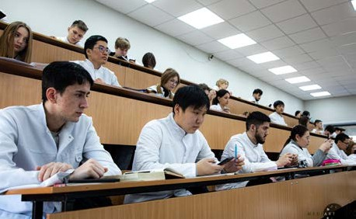

ELIGIBILITY CRITERIA
You are at least 17 years old.
You have passed Class 12th with PCB and English subjects from a board recognized by the Authorities in India.
You have secured a minimum of 50%(GEN) / 40%(OTHER) in PCB in 10+2.
You have qualified NEET Exam.
AT NORTH WESTERN STATE MEDICAL UNIVERSITY
The total duration of MBBS Course at North Western State Medical University is 6years including internship.
The practical / Internship for 1 year must be completed in India post course completion in abroad and after clearing FMGE / NEXT exam in India.
The Tuition fee is affordable with a great value as compared to Indian Medical Colleges.
Easy admission process, and the best selection process in university.
Medical degrees from North Western State Medical University are globally recognized and ranked by WHO.
Indian students who are looking to study MBBS in North Western State Medical University have English medium MBBS course, so, no language barrier.
The strength of the batch is limited, every student gets the individual attention of the teachers.
No discrimination based on caste, gender, religion or nationality.

Slide 3
NORTH WESTERN STATE MEDICAL UNIVERSITYRUSSIA, FOUNDED IN: 2011
PARTICULARS | 1ST YEAR | 2ND YEAR | 3rd YEAR | 4th YEAR | 5th YEAR | 6th YEAR
TUITION FEE | 550000 RUB | 550000 RUB | 550000 RUB | 550000 RUB | 550000 RUB | 550000 RUB
HOSTEL | 45000 RUB | 45000 RUB | 45000 RUB | 45000 RUB | 45000 RUB | 45000 RUB
INSURANCE | 7500 RUB | 8000 RUB | 8000 RUB | 8000 RUB | 8000 RUB | 8000 RUB
MEDICAL | 8000 RUB | NA | NA | NA | NA | NA
REGISTRATION, DOCUMENT TRANSLATION, NOTARIZATION, LEGALIZATION, INVITATION, VISA EXTENSION, STUDENT CARD, LIBRARY CARD, EQUIVALENCE CERTIFICATE, ACCESS TO ENGLISH BOOKS FOR ALL SUBJECTS. | 21000 RUB | VISA EXTENSION ON ACTUALS | VISA EXTENSION ON ACTUALS | VISA EXTENSION ON ACTUALS | VISA EXTENSION ON ACTUALS | VISA EXTENSION ON ACTUALS
ADMINISTRATIVE CHARGE (OTC) | 1300$ | NA | NA | NA | NA | NA
BIOMETRIC, FINGERPRINTING CHARGES WILL BE ON ACTUALS TO BE PAID BY STUDENT SEPERATELY.

