Slide 1
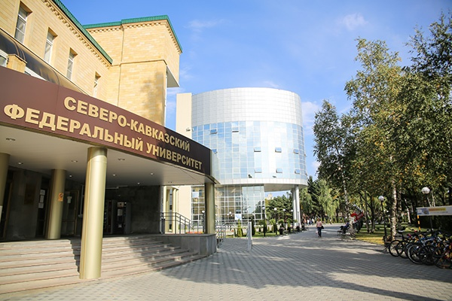

NORTH-CAUCASUS FEDERAL UNIVERSITY
The Faculty of Medicine and Biology was established in 2020 (STAVROPOL, RUSSIA)
The contingent of students and trainees of the Faculty of Medicine and Biology is over 1070 people. The accreditation of specialists in the specialties 31.05.01 Medical science, 06.05.02 Fundamental and applied biology, licensing of the specialty 05/31/03 Dentistry was completed.

Slide 2

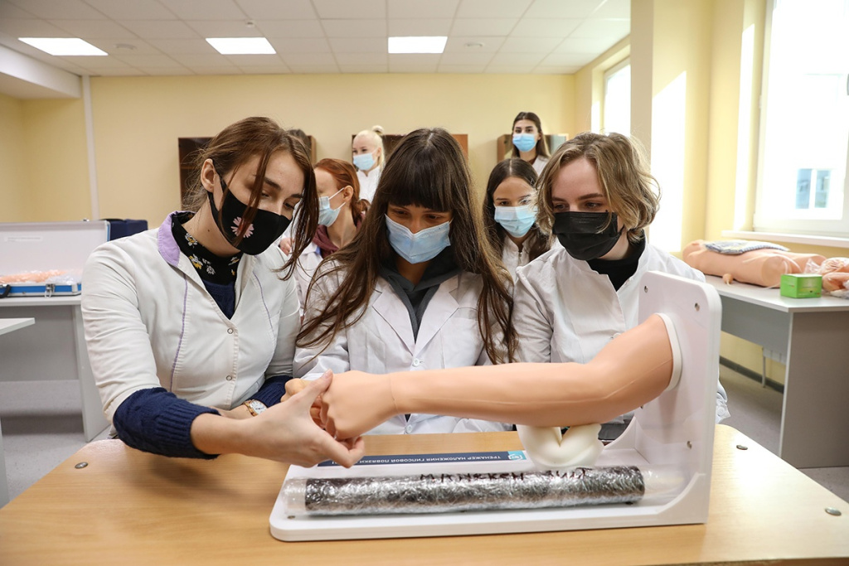

ABOUT UNIVERSITY
Located in the City of Stavropol (Russia), and given its staff of nearly 1,500 and a student body of around 25,000 people, NCFU is the largest academic institution in the region with two branch institutes in adjacent places.
Coming from a merger of three major regional universities, it is one of the ten Federal Universities of Russia, which was launched to follow a special mission – offer top quality training thus propelling the region’s economy, and this we have been doing with flying colors. Our graduates have found employment in numerous fields, many of them holding top offices in Ministries and agencies not in Russia alone yet far beyond this country.

Slide 3
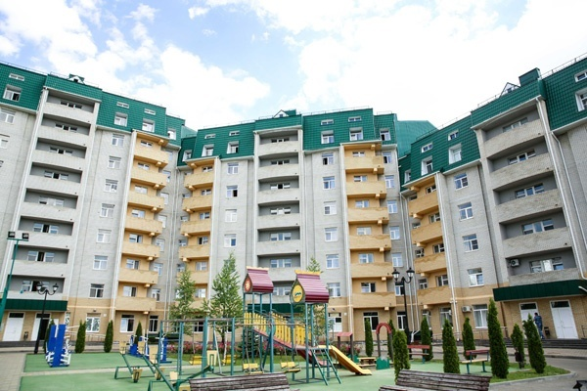
GOVERNMENT HOSTEL ACCOMODATION FOR FOREIGN STUDENTS
International students will be provided with more superior accommodation facilities!
Dormitory № 5, № 6, № 7 ---- Address: Stavropol, 2 Kulakova Av.

Slide 4
NORTH-CAUCASUS FEDERAL UNIVERSITY
PARTICULARS | 1ST YEAR | 2ND YEAR | 3rd YEAR | 4th YEAR | 5th YEAR | 6th YEAR
TUITION FEE | 320000 RUB | 320000 RUB | 320000 RUB | 320000 RUB | 320000 RUB | 320000 RUB
HOSTEL | 42000 RUB | 42000 RUB | 42000 RUB | 42000 RUB | 42000 RUB | 42000 RUB
INSURANCE | 10500 RUB | 10500 RUB | 10500 RUB | 10500 RUB | 10500 RUB | 10500 RUB
MEDICAL | 8000 RUB | NA | NA | NA | NA | NA
REGISTRATION, DOCUMENT TRANSLATION, NOTARIZATION, LEGALIZATION, INVITATION, VISA EXTENSION, STUDENT CARD, LIBRARY CARD, EQUIVALENCE CERTIFICATE, ACCESS TO ENGLISH BOOKS FOR ALL SUBJECTS. | 21000 RUB | VISA EXTENSION ON ACTUALS | VISA EXTENSION ON ACTUALS | VISA EXTENSION ON ACTUALS | VISA EXTENSION ON ACTUALS | VISA EXTENSION ON ACTUALS
ADMINISTRATIVE CHARGE (OTC) | 1300$ | NA | NA | NA | NA | NA
BIOMETRIC TO BE PAID ON ACTUALS AT THE DESTINATION

