Slide 1
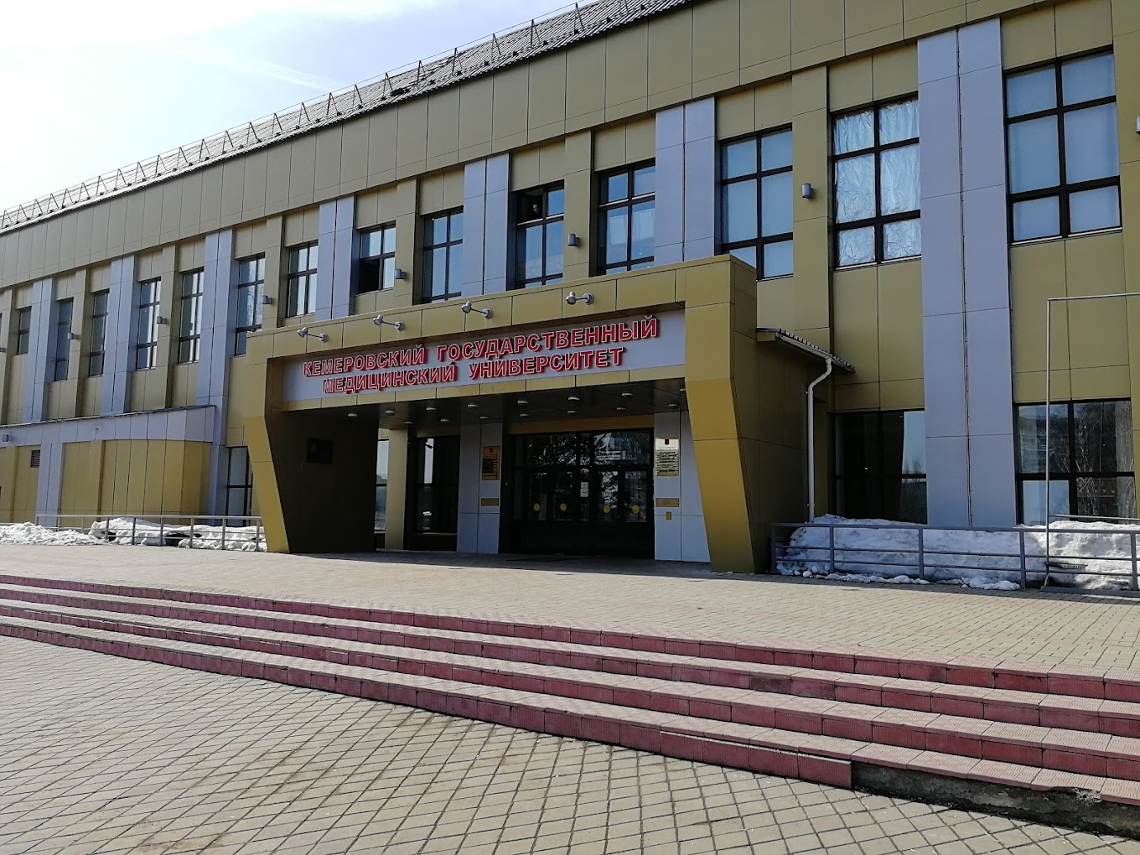
KEMEROVO STATE MEDICAL UNIVERSITY
Location: Kemerovo Oblast, Russia
Established in August 1955
Government Medical University
Today, the university has 7 faculties with more than 3500 students studying medicine at the faculty.

Slide 2
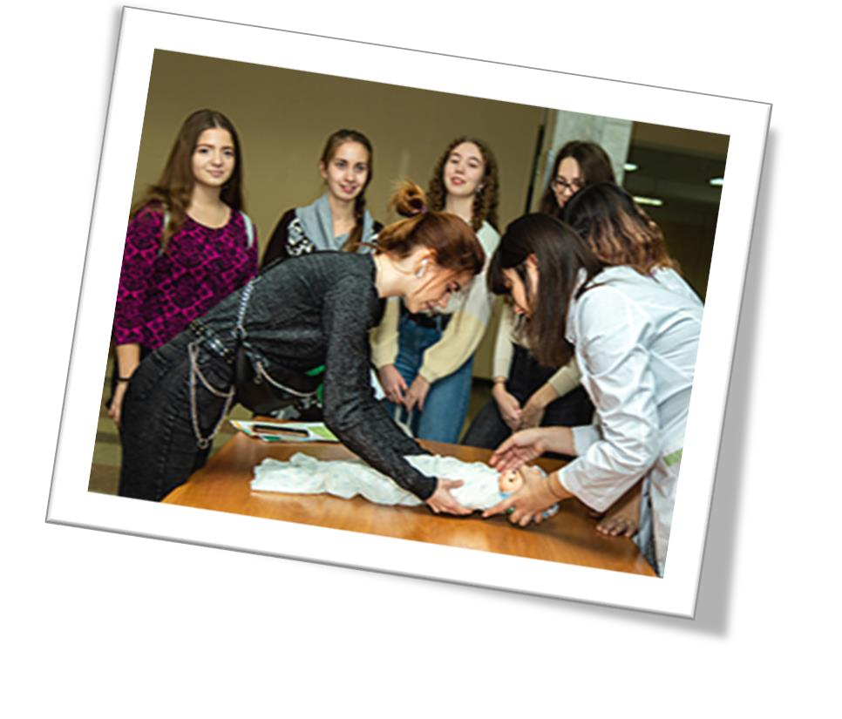
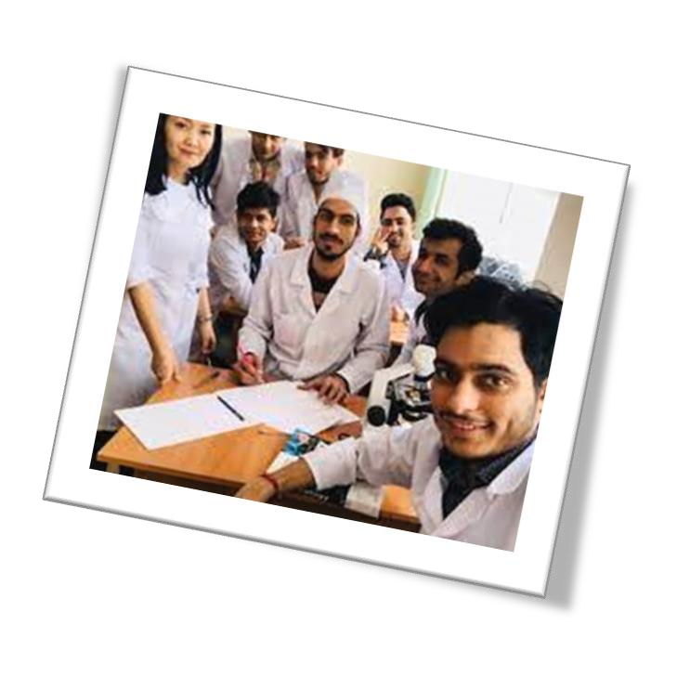

MBBS at Kemerovo State Medical University
The Kemerovo State Medical University organizes the implementation of educational programs at the international level of education.
The university has coordination with overseas universities to provide training in different specialties of medicine.
Medical students at the university will get an opportunity to work with renowned specialties of the world.
Faculties at the university strive to develop highly qualified
medical professionals through the academic development programs of the university.
Graduates from the Kemerovo State Medical University are
working in a different part of the countries as a doctor with a high Salary Package
*Admissions are based on a first come first served, subject to the candidate satisfying the eligibility criteria set by the Russian medical University and NMC (for Indian students).

Slide 3
KEMEROVO STATE MEDICAL UNIVERSITY RUSSIA, ESTABLISHED IN: 1955
PARTICULARS | 1ST YEAR | 2ND YEAR | 3rd YEAR | 4th YEAR | 5th YEAR | 6th YEAR
TUITION FEE | 335000 RUB | 335000 RUB | 335000 RUB | 335000 RUB | 335000 RUB | 335000 RUB
HOSTEL | 80000 RUB | 80000 RUB | 80000 RUB | 80000 RUB | 80000 RUB | 80000 RUB
INSURANCE | 7500 RUB | 7500 RUB | 7500 RUB | 7500 RUB | 7500 RUB | 7500 RUB
MEDICAL | 8000 RUB | NA | NA | NA | NA | NA
REGISTRATION, DOCUMENT TRANSLATION, NOTARIZATION, LEGALIZATION, INVITATION, VISA EXTENSION, STUDENT CARD, LIBRARY CARD, EQUIVALENCE CERTIFICATE, ACCESS TO ENGLISH BOOKS FOR ALL SUBJECTS. | 21000 RUB | VISA EXTENSION ON ACTUALS | VISA EXTENSION ON ACTUALS | VISA EXTENSION ON ACTUALS | VISA EXTENSION ON ACTUALS | VISA EXTENSION ON ACTUALS
ADMINISTRATIVE CHARGE (OTC) | 1300$ | NA | NA | NA | NA | NA
BIOMETRIC, FINGERPRINTING CHARGES WILL BE ON ACTUALS TO BE PAID BY STUDENT SEPERATELY.
MESS MANDATORY FOR 1ST YEAR 1300$

