Slide 1
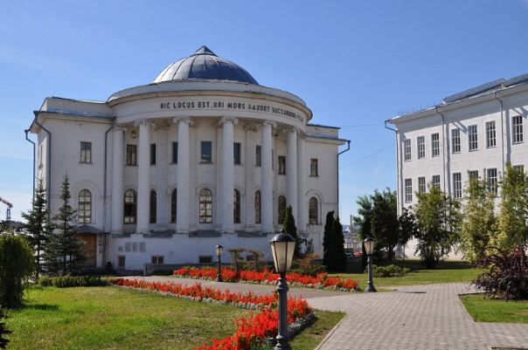

KAZAN STATE MEDICAL UNIVERSITY
LOCATION: KAZAN CITY, RUSSIA
ESTABLISHED: 1814
University Type: Government

Slide 2

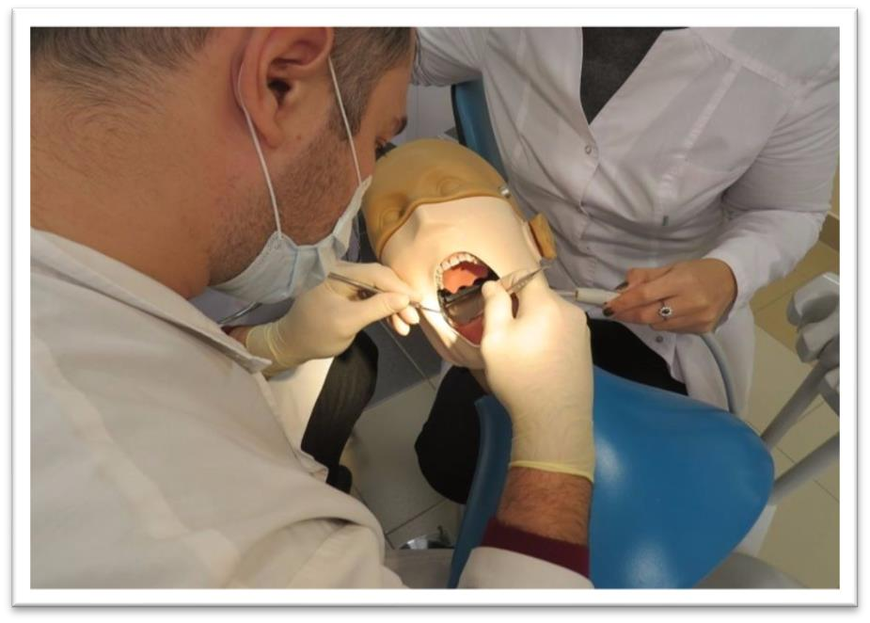
MBBS AT KAZAN STATE UNIVERSITY
The Tuition fee is low and affordable with a great value.
Easy admission process, and the best selection process in university.
Medical degrees from Kazan State University Russia are globally
recognized and ranked by WHO.
Indian students who are looking to study MBBS in Kazan State University have English medium MBBS course, so, no language barrier.
The strength of the batch is limited, every student gets the individual attention of the teachers.
Kazan State University is much more affordable than that of private colleges in India.
No discrimination based on caste, gender, religion or nationality.
DURATION OF COURSE
The total duíation of MBBS Couíse in Kazan State Univeísity is 6 years
including inteínship, in which 5 years of classíoom studies and 8 months of
internship. The practical for 1 year must be completed in India post
course completion and on clearing FMGE/NEXT exams.

Slide 3
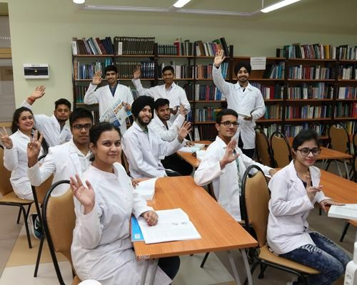
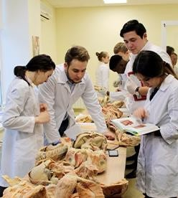

ELIGIBILITY CRITERIA
You are at least 17 years old.
You have passed Class 12th with PCB and English subjects from a board recognized by the Authorities in India.
You have secured a minimum of 50%(GEN) / 40%(OTHER) in PCB in 10+2.
You have qualified NEET Exam.
AT KAZAN STATE MEDICAL UNIVERSITY
The total duration of MBBS Course at Kazan state Medical University is 6years including internship.
The practical / Internship for 1 year must be completed in India post course completion in abroad and after clearing FMGE / NEXT exam in India.
The Tuition fee is low and affordable with a great value.
Easy admission process, and the best selection process in university.
Medical degrees from Kazan state Medical University are globally recognized and ranked by WHO.
Indian students who are looking to study MBBS in Kazan state Medical University have English medium MBBS course, so, no language barrier.
The strength of the batch is limited, every student gets the individual attention of the teachers.
Kazan state Medical University is much more affordable than that of private colleges in India.
No discrimination based on caste, gender, religion or nationality.

Slide 4
KAZAN STATE MEDICAL UNIVERSITY RUSSIA, ESTABLISHED IN: 1814
PARTICULARS | 1ST YEAR | 2ND YEAR | 3rd YEAR | 4th YEAR | 5th YEAR | 6th YEAR
TUITION FEE | 650000 RUB | 650000 RUB | 650000 RUB | 650000 RUB | 650000 RUB | 650000 RUB
HOSTEL | 80000 RUB | 80000 RUB | 80000 RUB | 80000 RUB | 80000 RUB | 80000 RUB
INSURANCE | 7500 RUB | 7500 RUB | 7500 RUB | 7500 RUB | 7500 RUB | 7500 RUB
MEDICAL | 8000 RUB | NA | NA | NA | NA | NA
REGISTRATION, DOCUMENT TRANSLATION, NOTARIZATION, LEGALIZATION, INVITATION, VISA EXTENSION, STUDENT CARD, LIBRARY CARD, EQUIVALENCE CERTIFICATE, ACCESS TO ENGLISH BOOKS FOR ALL SUBJECTS. | 21000 RUB | VISA EXTENSION ON ACTUALS | VISA EXTENSION ON ACTUALS | VISA EXTENSION ON ACTUALS | VISA EXTENSION ON ACTUALS | VISA EXTENSION ON ACTUALS
ADMINISTRATIVE CHARGE (OTC) | 1300$ | NA | NA | NA | NA | NA
BIOMETRIC, FINGERPRINTING CHARGES WILL BE ON ACTUALS TO BE PAID BY STUDENT SEPERATELY.

