Slide 1

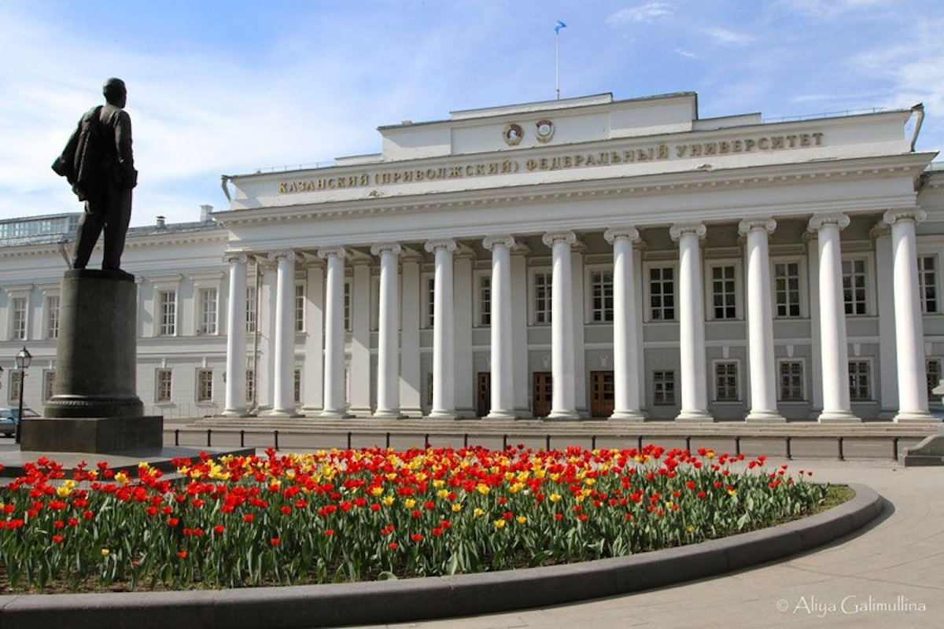
KAZAN FEDERAL UNIVERSITY
ESTB. IN 1804 KAZAN CITY, RUSSIA

Slide 2

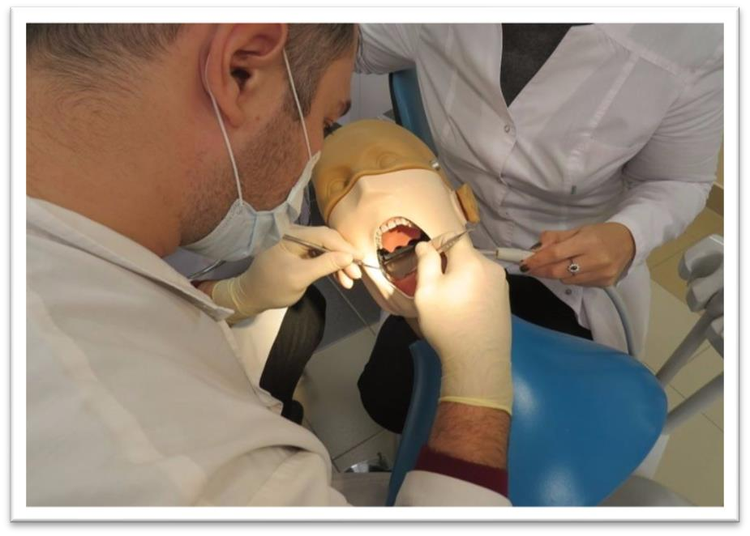
MBBS AT KAZAN FEDERAL UNIVERSITY
The Tuition fee is low and affordable with a great value.
Easy admission process, and the best selection process in university.
Medical degrees from Kazan Federal University Russia are globally
recognized and ranked by WHO.
Indian students who are looking to study MBBS in Kazan Federal University have English medium MBBS course, so, no language barrier.
The strength of the batch is limited, every student gets the individual attention of the teachers.
Kazan Federal University is much more affordable than that of private colleges in India.
No discrimination based on caste, gender, religion or nationality.
Duration of Course
ľhe total duíation of MBBS Couíse in Kazan Federal University is 6 years
including internship, in which 5 years of classíoom studies and 8 months of
apprrenticeship. The practical for 1 year must be completed in India post
course completion and on clearing FMGE/NEXT exams.

Slide 3
KAZAN FEDERAL UNIVERSITY RUSSIA, ESTABLISHED IN: 1804
PARTICULARS | 1ST YEAR | 2ND YEAR | 3rd YEAR | 4th YEAR | 5th YEAR | 6th YEAR
TUITION FEE | 653400 RUB | 653400 RUB | 653400 RUB | 653400 RUB | 653400 RUB | 653400 RUB
HOSTEL | 18000 RUB | 18000 RUB | 18000 RUB | 18000 RUB | 18000 RUB | 18000 RUB
INSURANCE | 4500 RUB | 4500 RUB | 4500 RUB | 4500 RUB | 4500 RUB | 4500 RUB
MEDICAL | 8000 RUB | NA | NA | NA | NA | NA
REGISTRATION, DOCUMENT TRANSLATION, NOTARIZATION, LEGALIZATION, INVITATION, VISA EXTENSION, STUDENT CARD, LIBRARY CARD, EQUIVALENCE CERTIFICATE, ACCESS TO ENGLISH BOOKS FOR ALL SUBJECTS. | 21000 RUB | VISA EXTENSION ON ACTUALS | VISA EXTENSION ON ACTUALS | VISA EXTENSION ON ACTUALS | VISA EXTENSION ON ACTUALS | VISA EXTENSION ON ACTUALS
ADMINISTRATIVE CHARGE (OTC) | 1300$ | NA | NA | NA | NA | NA
BIOMETRIC, FINGERPRINTING CHARGES WILL BE ON ACTUALS TO BE PAID BY STUDENT SEPERATELY.

