Slide 1
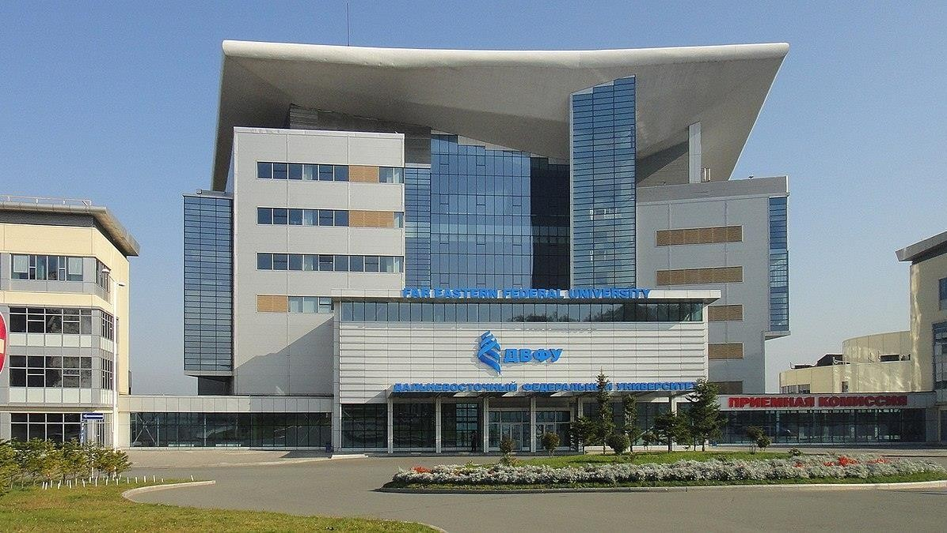
LOCATION: VLADIVOSTOK, RUSSIA ESTABLISHED IN: August 1899
FAR EASTERN FEDERAL UNIVERSITY

Slide 2
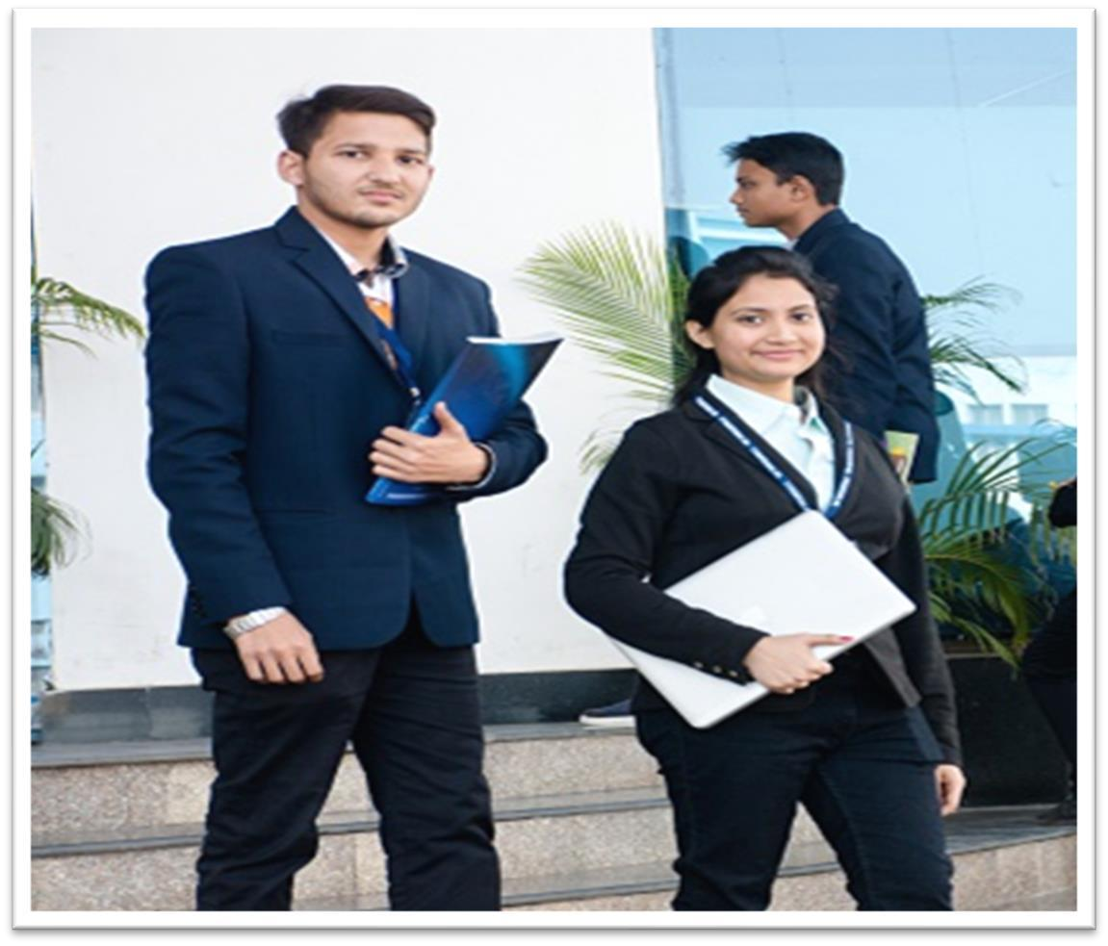
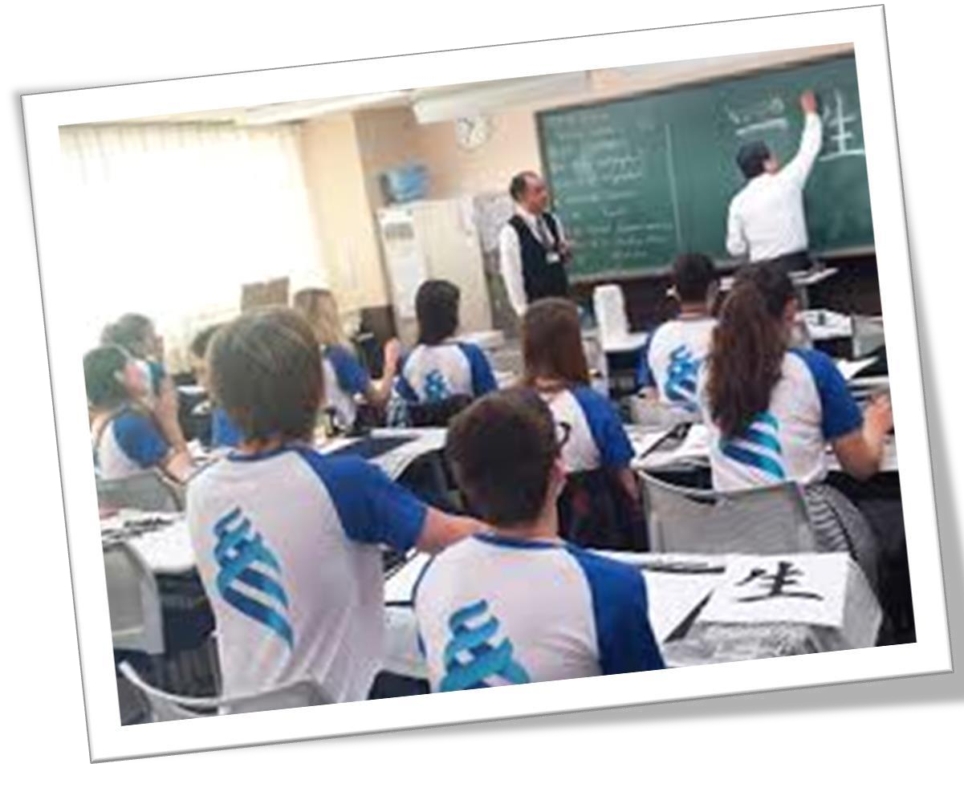
ELIGIBILITY CRITERIA
You are at least 17 years old.
You have passed Class 12th with PCB and English subjects from a board
recognized by the Authorities in India.
You have secured a minimum of 50%(GEN) / 40%(OTHER) in PCB in 10+2.
You have qualified NEET Exam.
AT FAR EASTERN FEDERAL UNIVERSITY
The total duration of MBBS Course at FAR EASTERN FEDERAL UNIVERSITY
is 6years including internship.
The practical / Internship for 1 year must be completed in India post course completion
in abroad and after clearing FMGE / NEXT exam in India.
The Tuition fee is low and affordable with a great value.
Easy admission process, and the best selection process in university.
Medical degrees from FAR EASTERN FEDERAL UNIVERSITY are globally recognized and
ranked by WHO.
Indian students who are looking to study MBBS in Ulyanovsk State University have English
medium MBBS course, so, no language barrier.
The strength of the batch is limited, every student gets the individual attention of the teachers.
FAR EASTERN FEDERAL UNIVERSITY is much more affordable than that of private colleges
in India.
No discrimination based on caste, gender, religion or nationality.

Slide 3

WHY MBBS IN FAR EASTERN FEDERAL UNIVERSITY
Far Eastern Federal University is Recognized and Approved by NMC & WHO.
Far Eastern Federal University provides an Innovative learning process for all programs.
The university also offers Comfortable dormitory
facility and safe environment on the campus.
Far Eastern University is Supported by an advanced and Development center for study purpose.
  The Medical degree from Far Eastern Federal University is accepted globally, It means you can practice in any country after completing an MBBS course from Far Eastern Federal University.
  Due to the commendable fee structure of Far Eastern Federal University, the students manage to complete the Medical studies at a reasonable cost.
  The Infrastructure of Far Eastern Federal University comprises laboratories and education
equipment make the university the most prestigious Institution of medical studies.

Slide 4
FAR EASTERN FEDERAL UNIVERSITY RUSSIA, ESTABLISHED IN: 1899
PARTICULARS | 1ST YEAR | 2ND YEAR | 3rd YEAR | 4th YEAR | 5th YEAR | 6th YEAR
TUITION FEE | 500000 RUB | 500000 RUB | 500000 RUB | 500000 RUB | 500000 RUB | 500000 RUB
HOSTEL | 8000 RUB / MONTH | 8000 RUB / MONTH | 8000 RUB / MONTH | 8000 RUB / MONTH | 8000 RUB / MONTH | 8000 RUB / MONTH
INSURANCE | 4500 RUB | 4500 RUB | 4500 RUB | 4500 RUB | 4500 RUB | 4500 RUB
MEDICAL | 8000 RUB | NA | NA | NA | NA | NA
REGISTRATION, DOCUMENT TRANSLATION, NOTARIZATION, LEGALIZATION, INVITATION, VISA RENEWAL, STUDENT CARD, LIBRARY CARD, EQUIVALENCE CERTIFICATE, ACCESS TO ENGLISH BOOKS FOR ALL SUBJECTS. | 21000 RUB | VISA RENEWAL (3900 RUBLES) | VISA RENEWAL (3900 RUBLES) | VISA RENEWAL (3900 RUBLES) | VISA RENEWAL (3900 RUBLES) | VISA RENEWAL (3900 RUBLES)
ADMINISTRATIVE CHARGE (OTC) | 1300$ | NA | NA | NA | NA | NA
BIOMETRIC CHARGES WILL BE ON ACTUALS TO BE PAID BY STUDENT SEPERATELY.
APPLICATION CHARGES TO BE PAID TO UNIVERSITY PORTAL BEFORE INVITATION (8760 rubles).

