Slide 1

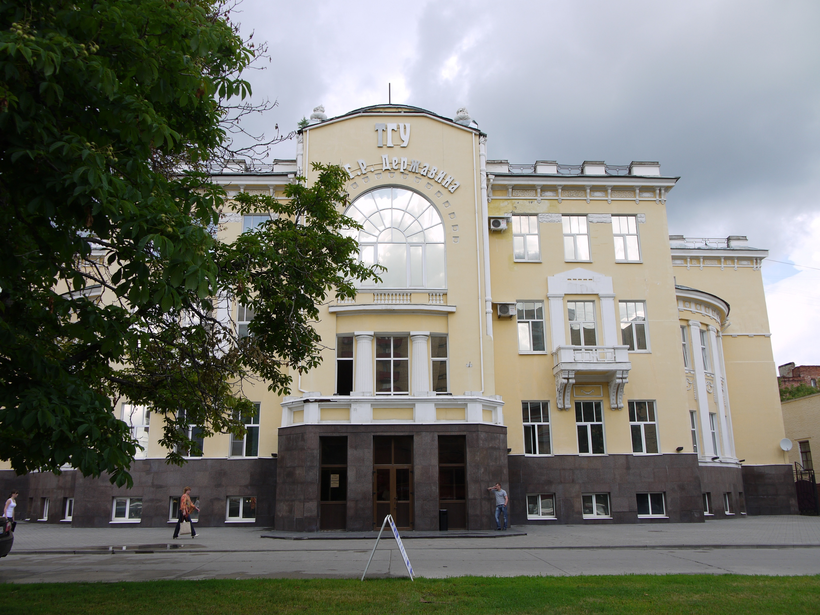
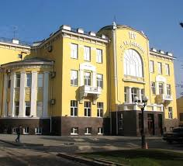
ESTB. 1917, TAMBOV RUSSIA
Tambov State University, established in 1917, is a public medical university in Russia recognized by the Medical Council of India (MCI) and the World Health Organization (WHO). It offers a 6-year MBBS program taught in English, and is known for its affordable education, modern facilities, and globally accepted degree.
Ranking: The university is ranked among the top 2500 worldwide and is within the top 150-200 in Russia, with a 401-450 ranking in the 2022 EECA University Rankings.
Student Demographic: TSU is a large regional university with thousands of students, including a significant international student body, particularly from India.
Recognized Degree: The qualifications are approved by global authorities, ensuring graduates can work or study further in their home countries.
Practical Training: Emphasizes practical skills through simulation labs and hospital affiliations from the beginning of the program

Slide 2
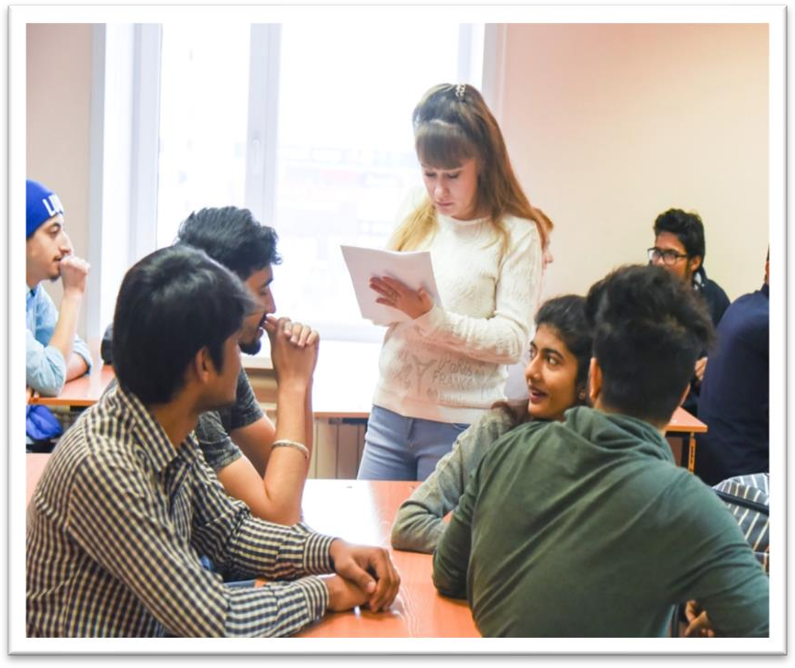
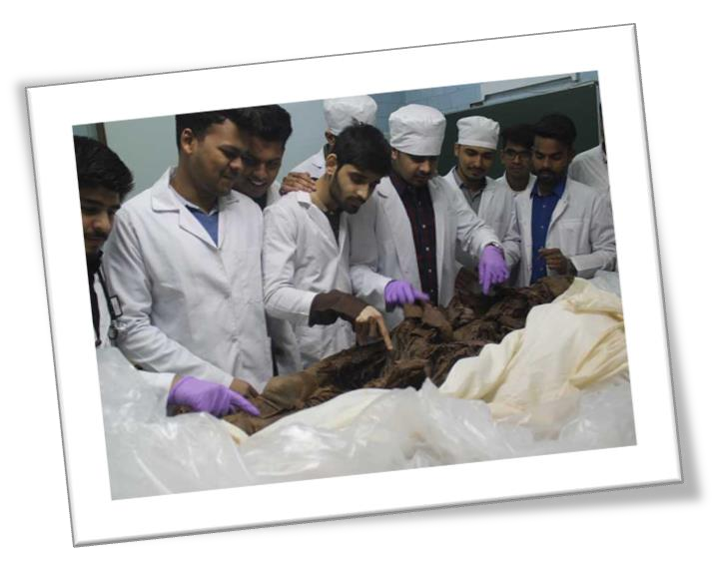
ELIGIBILITY CRITERIA
You are at least 17 years old.
You have passed Class 12th with PCB and English subjects from a board recognized by the Authorities in India.
You have secured a minimum of 50%(GEN) / 40%(OTHER) in PCB in 10+2.
You have qualified NEET Exam.
AT DERZHAVIN TAMBOV STATE UNIVERSITY
The total duration of MBBS Course at Tambov state University is 6years including internship.
The practical / Internship for 1 year must be completed in India post course completion in abroad and after clearing FMGE / NEXT exam in India.
The Tuition fee is low and affordable with a great value.
Easy admission process, and the best selection process in university.
Medical degrees from Tambov state University are globally recognized and ranked by WHO.
Indian students who are looking to study MBBS in Tambov state University have English medium MBBS course, so, no language barrier.
The strength of the batch is limited, every student gets the individual attention of the teachers.
Tambov state University is much more affordable than that of private colleges in India.
No discrimination based on caste, gender, religion or nationality.

Slide 3
DERZHAVIN TAMBOV STATE UNIVERSITY TAMBOV, RUSSIA ESTB.1917
PARTICULARS | 1ST YEAR | 2ND YEAR | 3rd YEAR | 4th YEAR | 5th YEAR | 6th YEAR
TUITION FEE | 410000 RUB | 410000 RUB | 410000 RUB | 410000 RUB | 410000 RUB | 410000 RUB
HOSTEL | INCLUDED | INCLUDED | INCLUDED | INCLUDED | INCLUDED | INCLUDED
INSURANCE | 7500 RUB | 7500 RUB | 7500 RUB | 7500 RUB | 7500 RUB | 7500 RUB
MEDICAL | 8000 RUB | NA | NA | NA | NA | NA
REGISTRATION, DOCUMENT TRANSLATION, NOTARIZATION, LEGALIZATION, INVITATION, VISA EXTENSION, STUDENT CARD, LIBRARY CARD, EQUIVALENCE CERTIFICATE, ACCESS TO ENGLISH BOOKS FOR ALL SUBJECTS. | 21000 RUB | VISA EXTENSION ON ACTUALS | VISA EXTENSION ON ACTUALS | VISA EXTENSION ON ACTUALS | VISA EXTENSION ON ACTUALS | VISA EXTENSION ON ACTUALS
ADMINISTRATIVE CHARGE (OTC) | 1300$ | NA | NA | NA | NA | NA
BIOMETRIC, FINGERPRINTING CHARGES WILL BE ON ACTUALS TO BE PAID BY STUDENT SEPERATELY.

