Slide 1
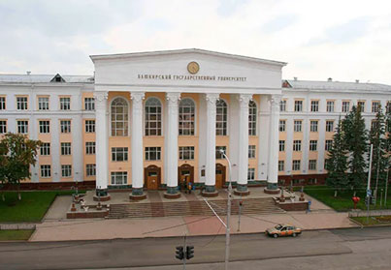
BASHKIR STATE MEDICAL UNIVERSITY
(Ufa, Russia)
ESTABLISHED IN 1932

Slide 2
ABOUT UNIVERSITY
Bashkir State Medical University has five faculties:
Faculty of Dentistry
Faculty of General Medicine (MBBS)
Faculty of Nursing
Faculty of Pediatrics
Faculty of Pharmacy
Faculty of Preventive Medicine
Established in 1932 Bashkir State Medical University is one of the Best Universities for medical education (MBBS) in Russia. Medical education (MBBS) in Bashkir State Medical University is Affordable medical education. Bashkir State Medical University is more than 85 years old Government University. Bashkir State Medical University is one of the oldest high education establishments in the state of Bashkortostan, Russia.
Bashkir State Medical University is licensed by the Ministry of Education of the Russian Federation to train international students.
Medical education in Bashkir State Medical University is affordable with excellent campus, top ranking and a large number of Indian students. Bashkir State Medical University is one of the most popular & chosen medical universities in Russia. More than 1500+ international students are studying MBBS equivalent course at the university. Bashkir State Medical University has very well-equipped laboratories with modern equipment's.
Bashkir State Medical University is recognized by various organizations globally those include:
Ministry of Science and Higher Education, Russia
Education Commission for Foreign Medical Graduates (ECFMG);
Foundation for Advancement of International Medical Education and Research (FAIMER).
National Medical Commission (erstwhile Medical Council of India);
World Directory of Medical Schools (WDOMS);
Medical Council of Canada and many more

Slide 3
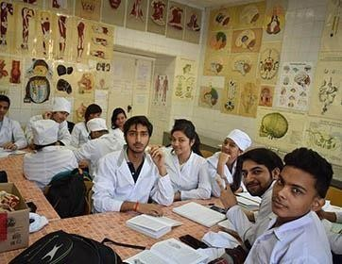
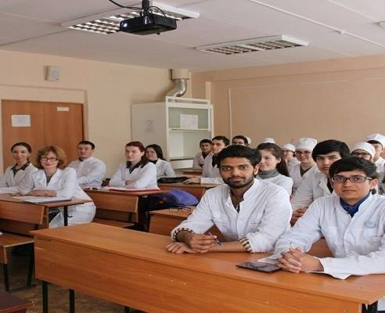
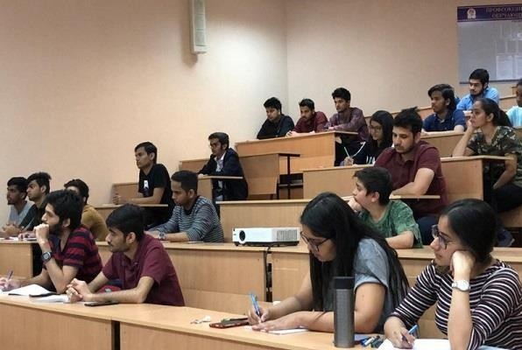
ELIGIBILITY CRITERIA
You are at least 17 years old.
You have passed Class 12th with PCB and English subjects from a board recognized by the Authorities in India.
You have secured a minimum of 50%(GEN) / 40%(OTHER) in PCB in 10+2.
You have qualified NEET Exam.
AT BASHKIR STATE MEDICAL UNIVERSITY
The total duration of MBBS Course at Bashkir state Medical University is 6years including internship.
The practical / Internship for 1 year must be completed in India post course completion in abroad and after clearing FMGE / NEXT exam in India.
The Tuition fee is low and affordable with a great value.
Medical degrees from Bashkir state Medical University are globally recognized and ranked by WHO.
Indian students who are looking to study MBBS in Bashkir state Medical University have English medium MBBS course, so, no language barrier.
The strength of the batch is limited, every student gets the individual attention of the teachers.
Bashkir state Medical University is much more affordable than that of private colleges in India.
No discrimination based on caste, gender, religion or nationality.

Slide 4
BASHKIR STATE MEDICAL UNIVERSITY UFA, RUSSIA ESTABLISHED IN: 1932
PARTICULARS | 1ST YEAR | 2ND YEAR | 3rd YEAR | 4th YEAR | 5th YEAR | 6th YEAR
TUITION FEE | 405000 RUB | 405000 RUB | 405000 RUB | 405000 RUB | 405000 RUB | 405000 RUB
HOSTEL | 45000 RUB | 45000 RUB | 45000 RUB | 45000 RUB | 45000 RUB | 45000 RUB
INSURANCE | 5000 RUB | 5000 RUB | 5000 RUB | 5000 RUB | 5000 RUB | 5000 RUB
MEDICAL | 8000 RUB | NA | NA | NA | NA | NA
REGISTRATION, DOCUMENT TRANSLATION, NOTARIZATION, LEGALIZATION, INVITATION, VISA EXTENSION, STUDENT CARD, LIBRARY CARD, EQUIVALENCE CERTIFICATE, ACCESS TO ENGLISH BOOKS FOR ALL SUBJECTS. | 21000 RUB | VISA EXTENSION ON ACTUALS | VISA EXTENSION ON ACTUALS | VISA EXTENSION ON ACTUALS | VISA EXTENSION ON ACTUALS | VISA EXTENSION ON ACTUALS
ADMINISTRATIVE CHARGE (OTC) | 1300$ | NA | NA | NA | NA | NA
BIOMETRIC, FINGERPRINTING CHARGES WILL BE ON ACTUALS TO BE PAID BY STUDENT SEPERATELY.

