Slide 1
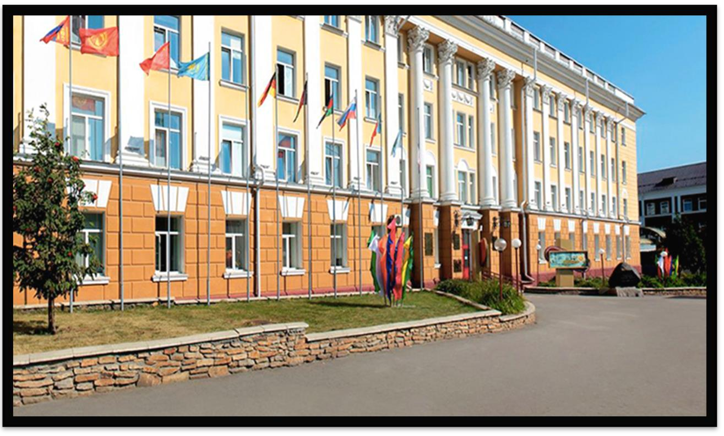
ALTAI STATE MEDICAL UNIVERSITY

Slide 2
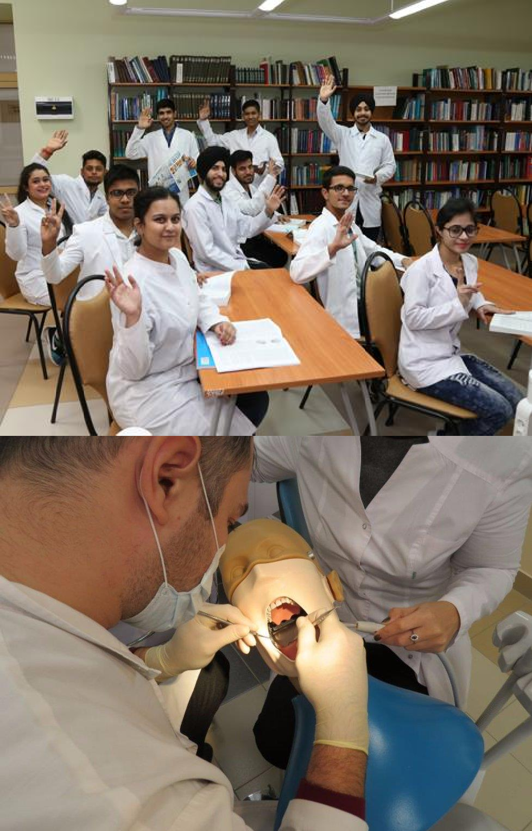
ELIGIBILITY CRITERIA
You are at least 17 years old.
You have passed Class 12th with PCB and English subjects from a board recognized by the Authorities in India.
You have secured a minimum of 50%(GEN) / 40%(OTHER) in PCB in 10+2.
You have qualified NEET Exam.
AT ALTAI STATE MEDICAL UNIVERSITY
The total duration of MBBS Course in Altai State Medical University is 6years including internship.
The practical / Internship for 1 year must be completed in India post course completion in abroad and after clearing FMGE / NEXT exam in India.
The Tuition fee is low and affordable with a great value.
Easy admission process, and the best selection process in university.
Medical degrees from Altai State Medical University are globally recognized and ranked by WHO.
Indian students who are looking to study MBBS in Altai State Medical University have English medium MBBS course, so, no language barrier.
The strength of the batch is limited, every student gets the individual attention of the teachers.
Altai State Medical University is much more affordable than that of private colleges in India.
No discrimination based on caste, gender, religion or nationality.

Slide 3
ALTAI STATE MEDICAL UNIVERSITY RUSSIA, ESTABLISHED IN: 1954
PARTICULARS | 1ST YEAR | 2ND YEAR | 3rd YEAR | 4th YEAR | 5th YEAR | 6th YEAR
TUITION FEE | 380000 RUB | 380000 RUB | 380000 RUB | 380000 RUB | 380000 RUB | 380000 RUB
HOSTEL | 90000 RUB | 90000 RUB | 90000 RUB | 90000 RUB | 90000 RUB | 90000 RUB
INSURANCE | 7500 RUB | 7500 RUB | 7500 RUB | 7500 RUB | 7500 RUB | 7500 RUB
MEDICAL | 8000 RUB | NA | NA | NA | NA | NA
REGISTRATION, DOCUMENT TRANSLATION, NOTARIZATION, LEGALIZATION, INVITATION, VISA EXTENSION, STUDENT CARD, LIBRARY CARD, EQUIVALENCE CERTIFICATE, ACCESS TO ENGLISH BOOKS FOR ALL SUBJECTS. | 21000 RUB | VISA EXTENSION ON ACTUALS | VISA EXTENSION ON ACTUALS | VISA EXTENSION ON ACTUALS | VISA EXTENSION ON ACTUALS | VISA EXTENSION ON ACTUALS
ADMINISTRATIVE CHARGE (OTC) | 1300$ | NA | NA | NA | NA | NA
BIOMETRIC, FINGERPRINTING CHARGES WILL BE ON ACTUALS TO BE PAID BY STUDENT SEPERATELY.
MESS MANDATORY FOR 1ST YEAR 1300$

